Slide 1
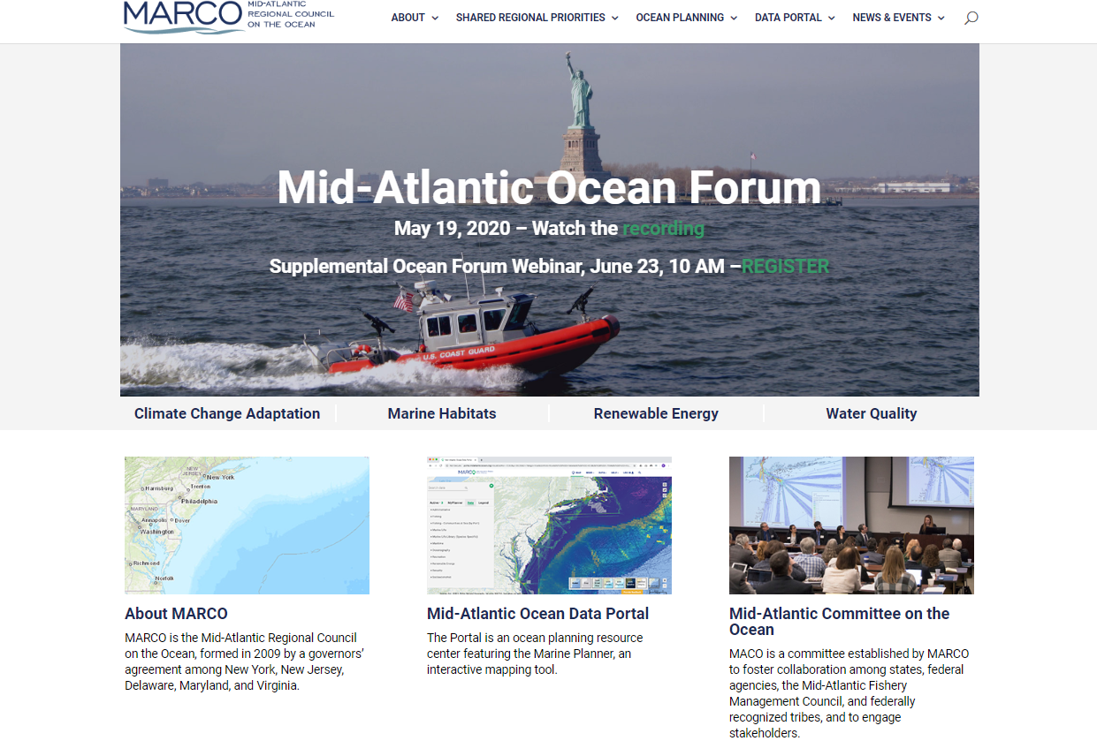

Slide 7
How you can get involved… About -> Opportunities to Participate

