Slide 1
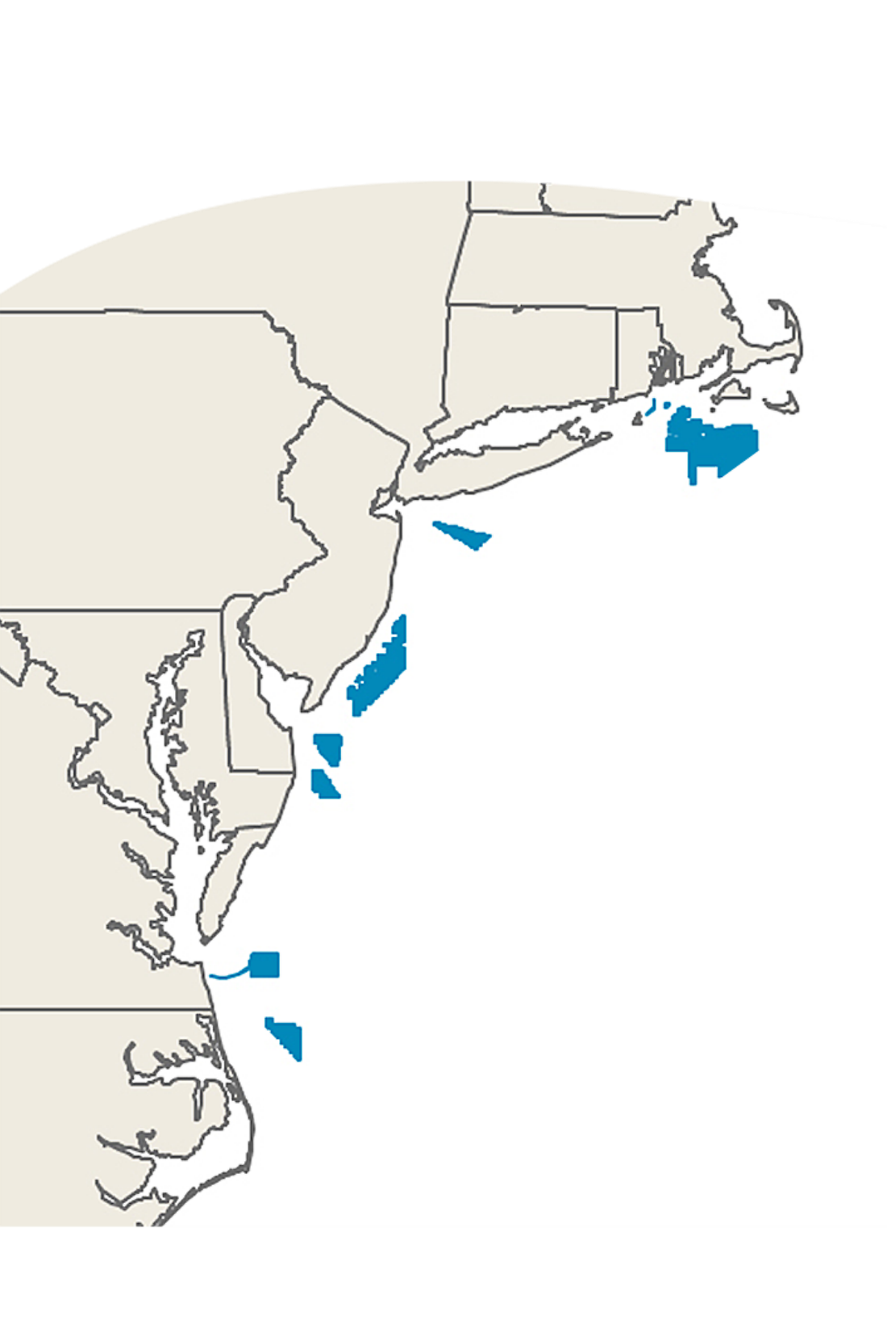
Renewable Energy & the Atlantic OCS: State Leadership
Awards/Goals (MW) State Renewable Goals
Massachusetts
3,200 35% by 2030
Rhode Island
1,000 38.5% by 2025
Connecticut
300 48% by 2030
New York
9,000 70% by 2030
New Jersey
3,500 50% by 2030
Maryland
368 25% by 2020
TOTAL
17,368 MW

Slide 2
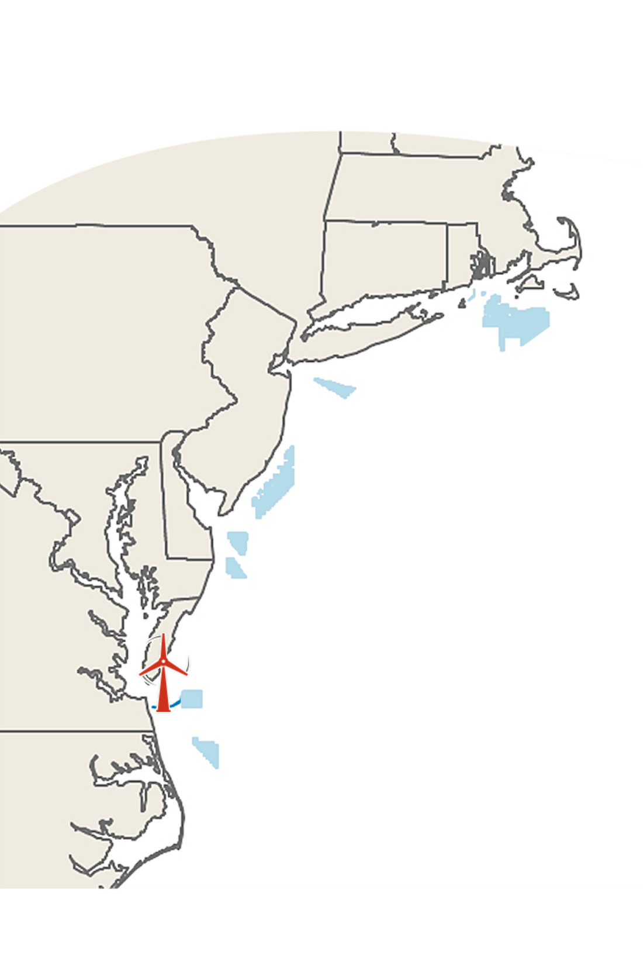
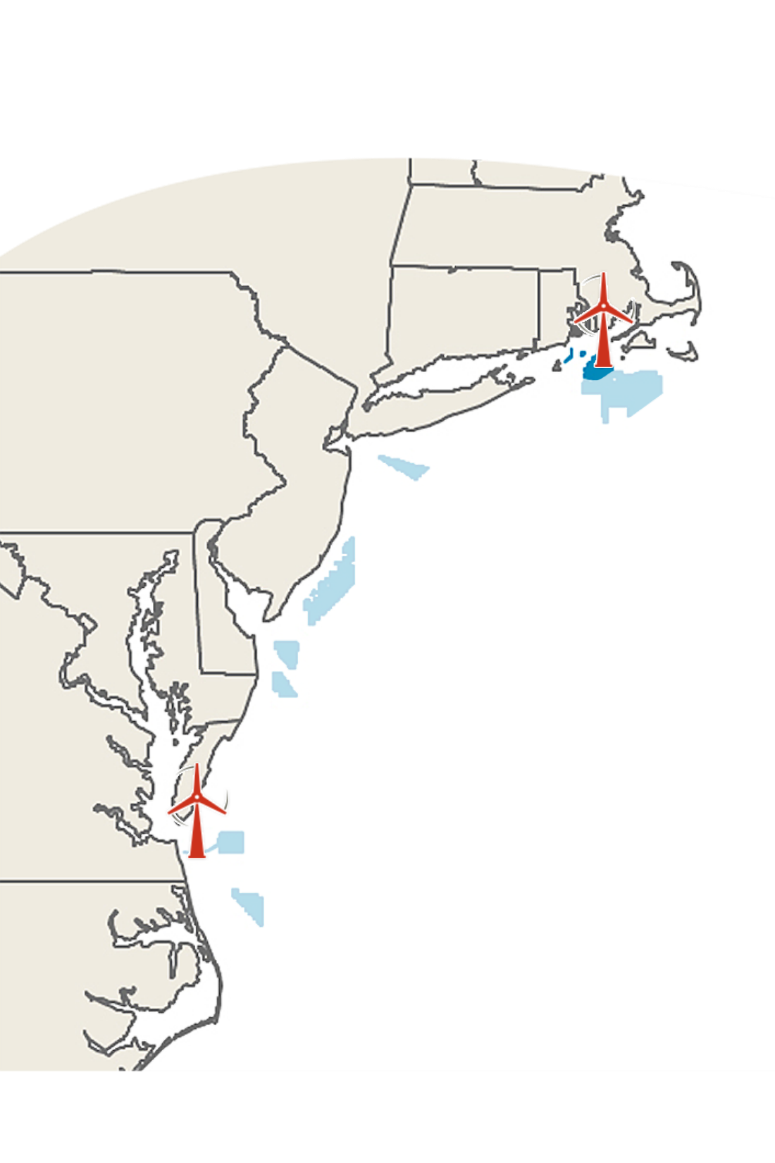
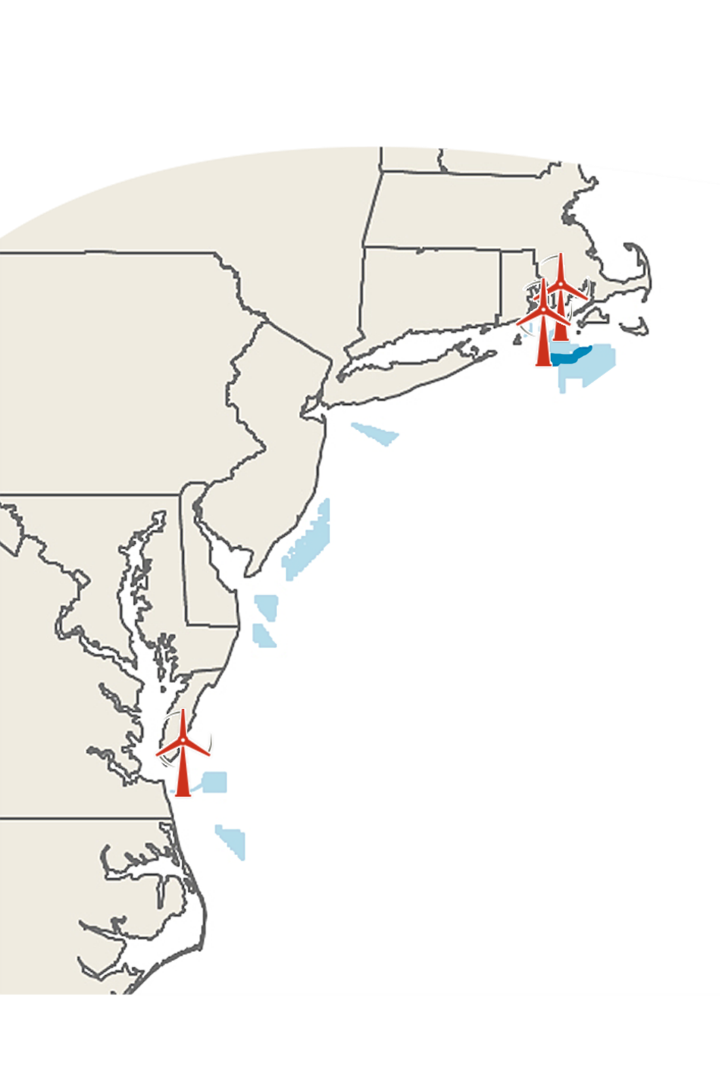
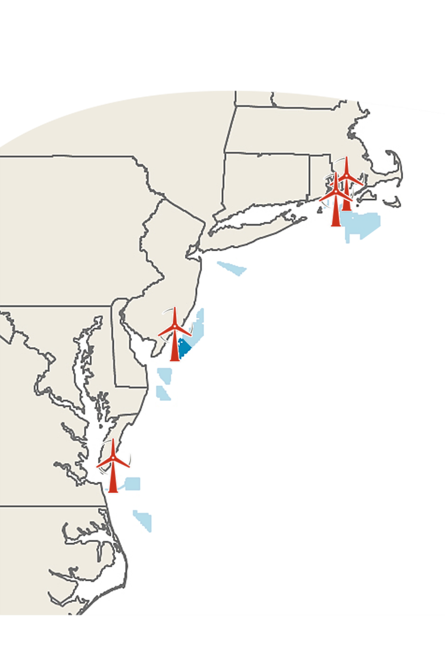
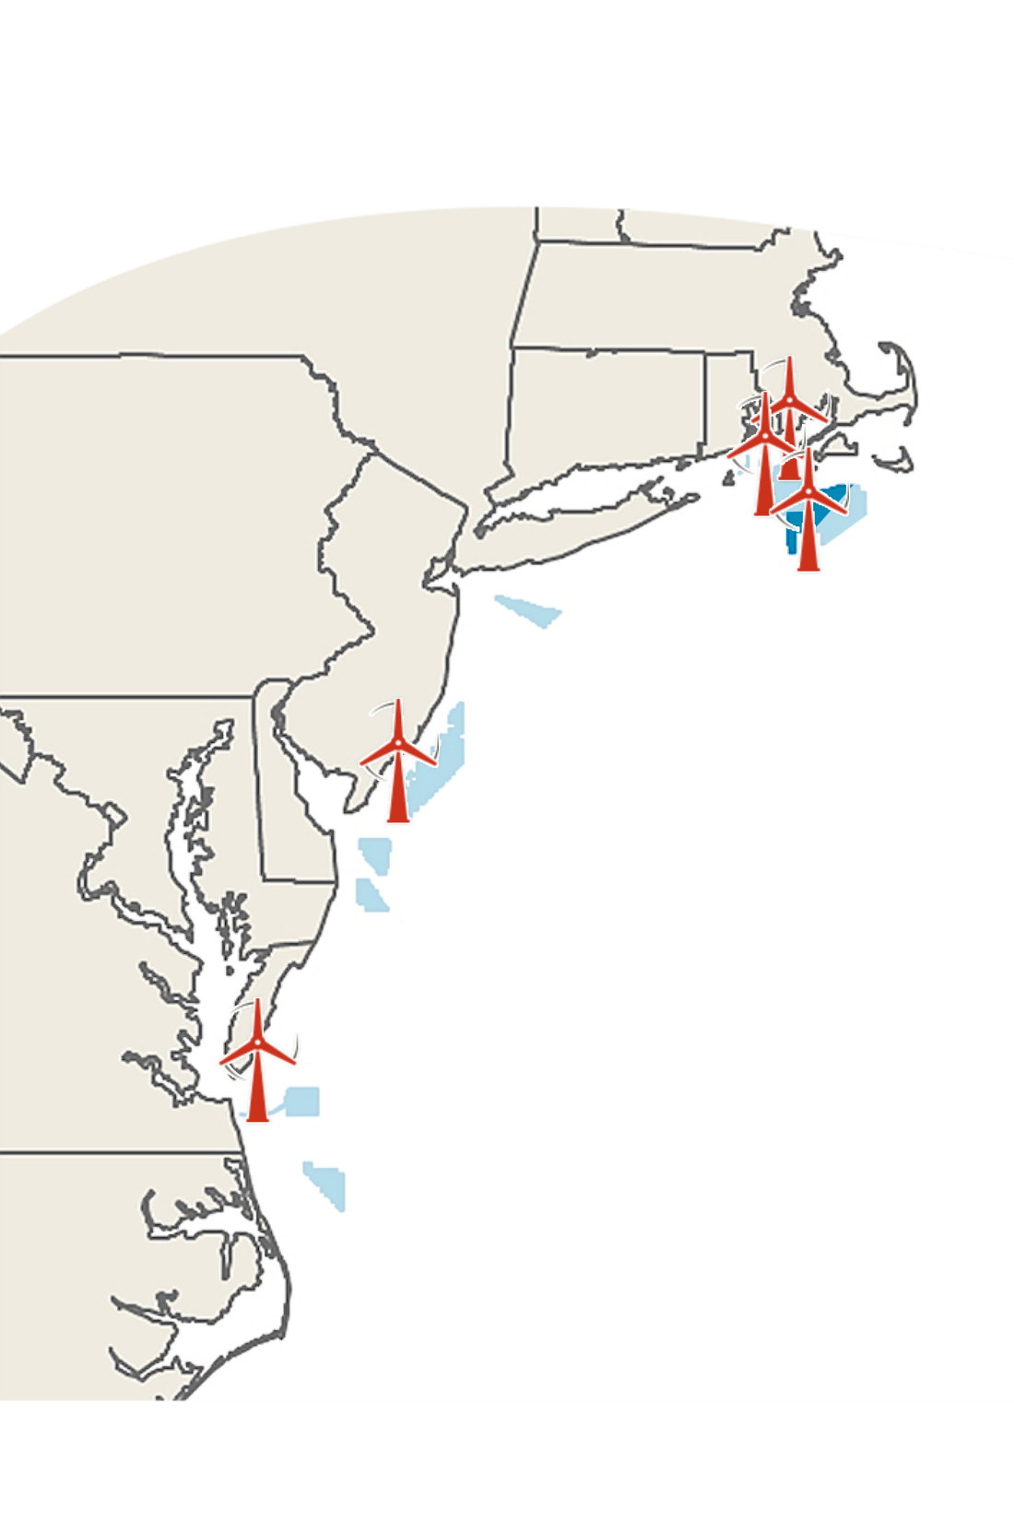
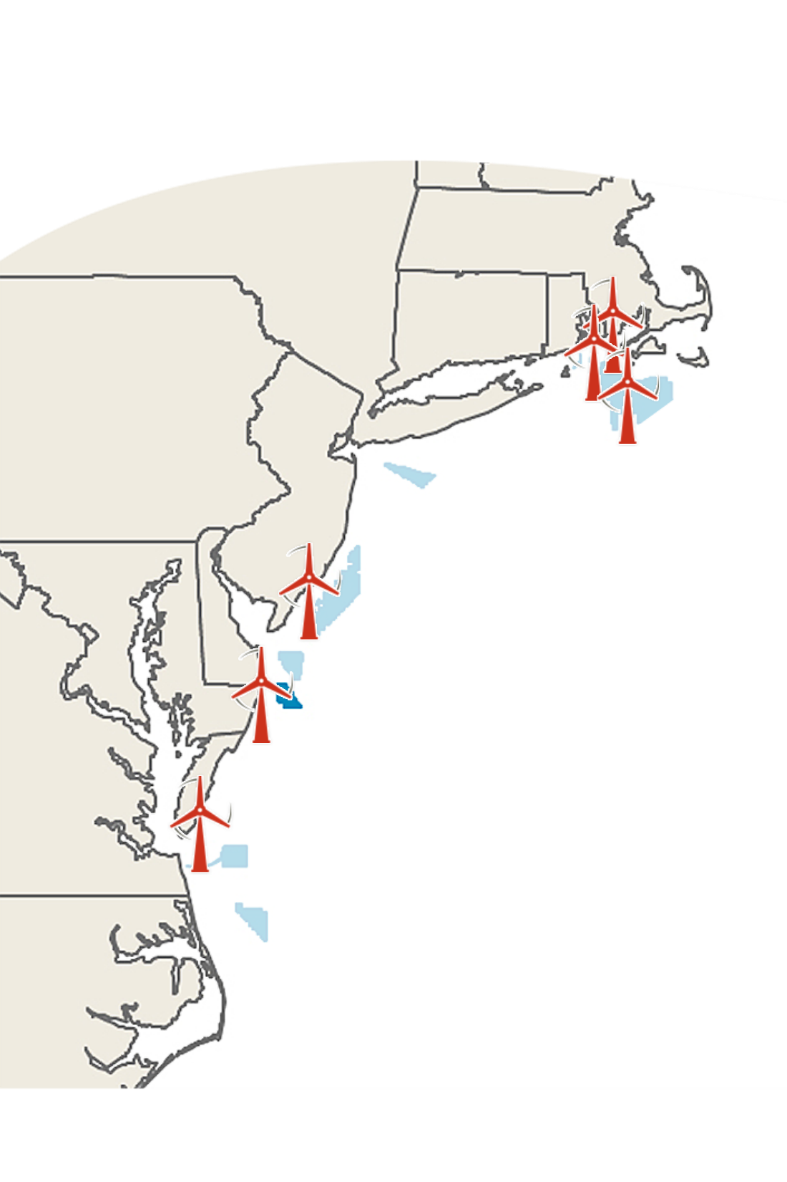
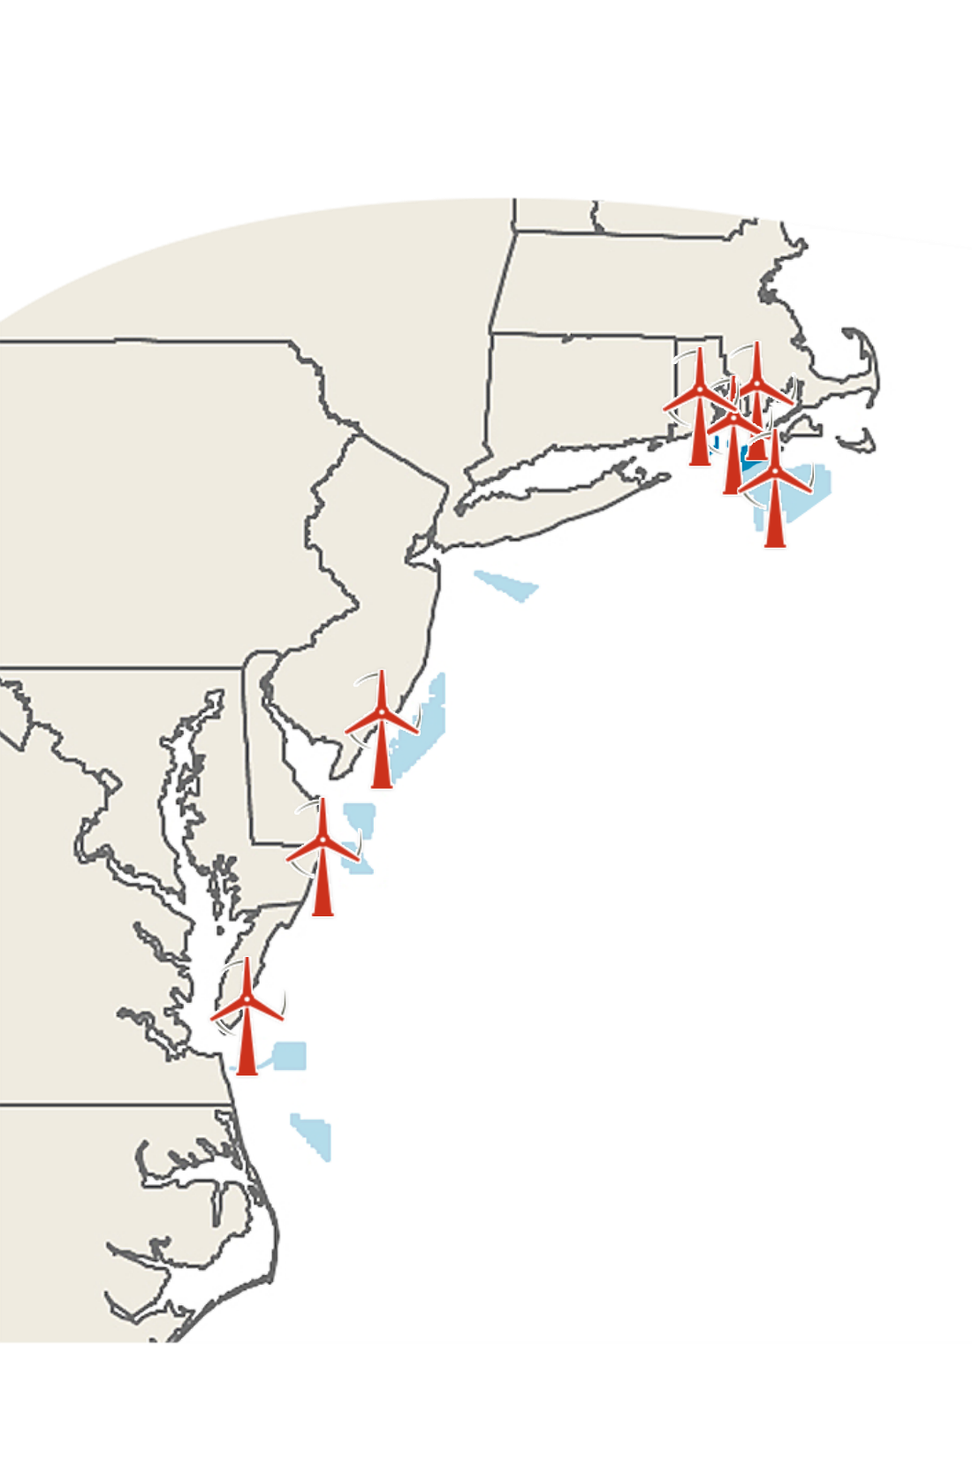
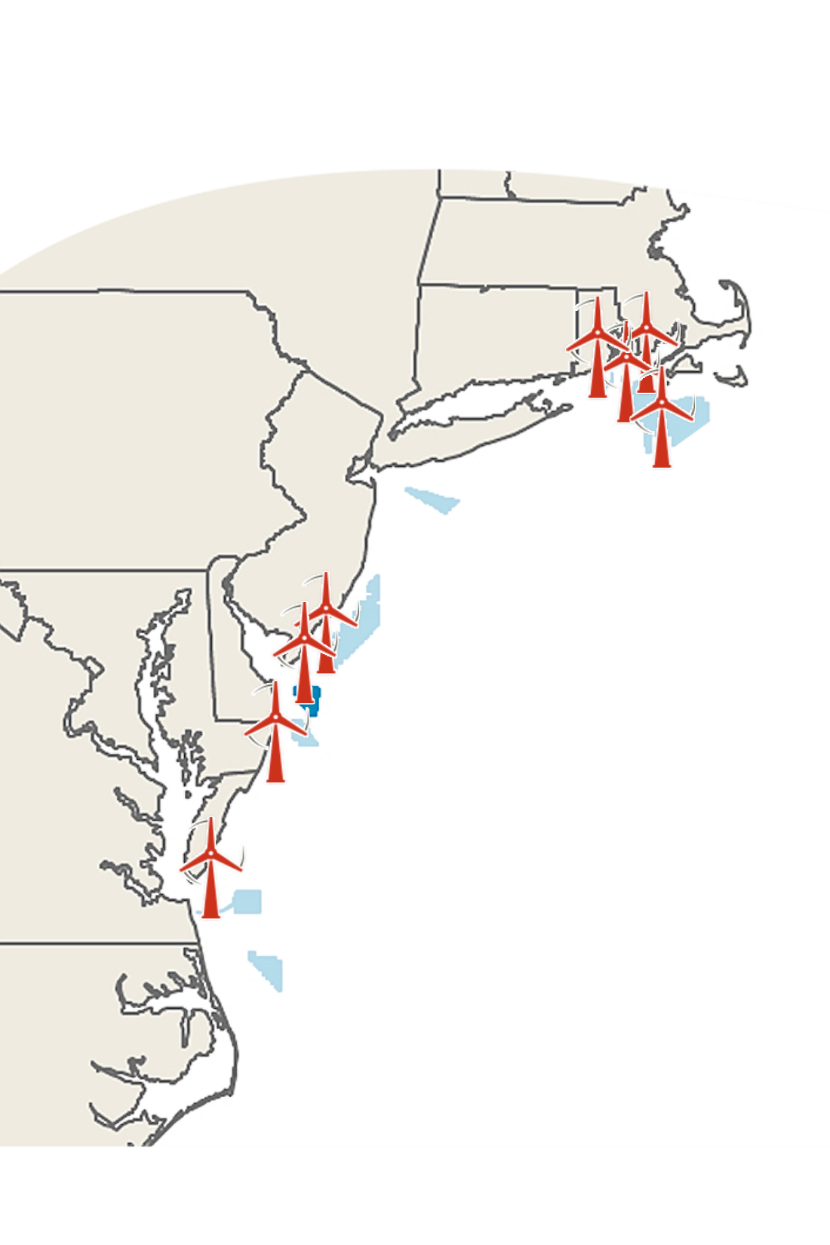
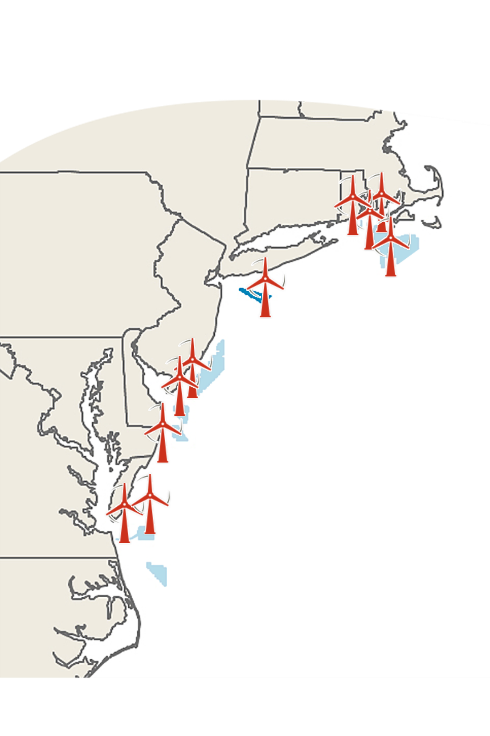
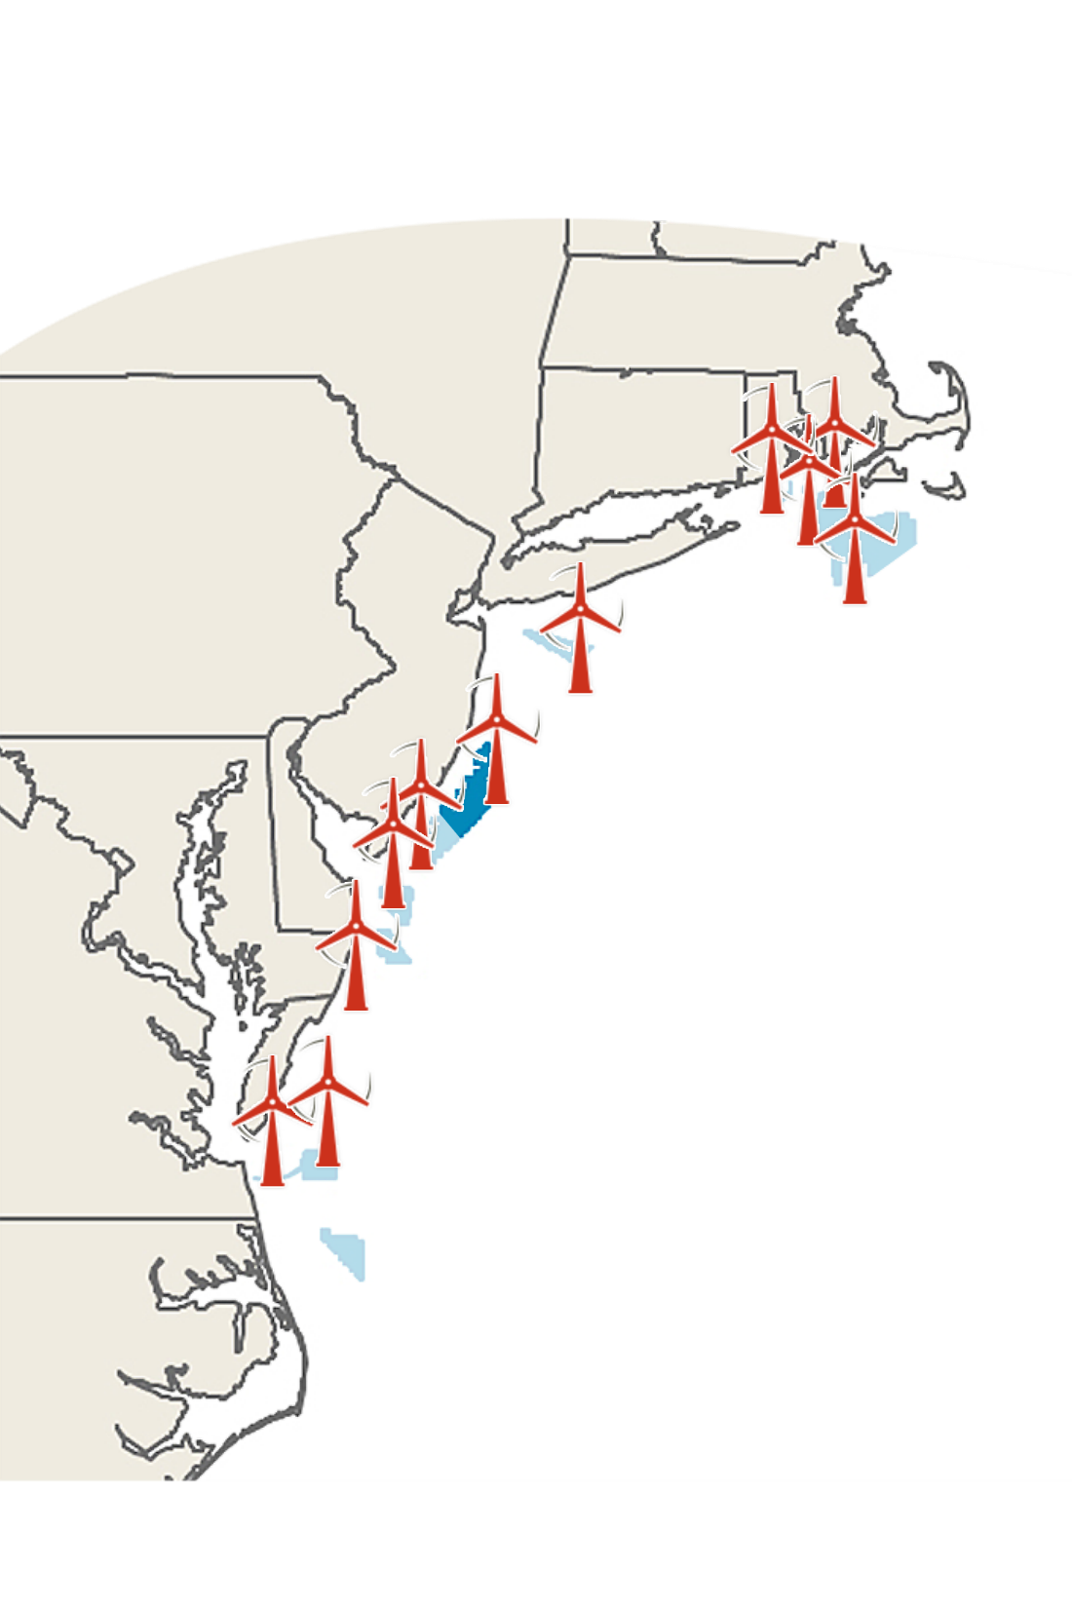
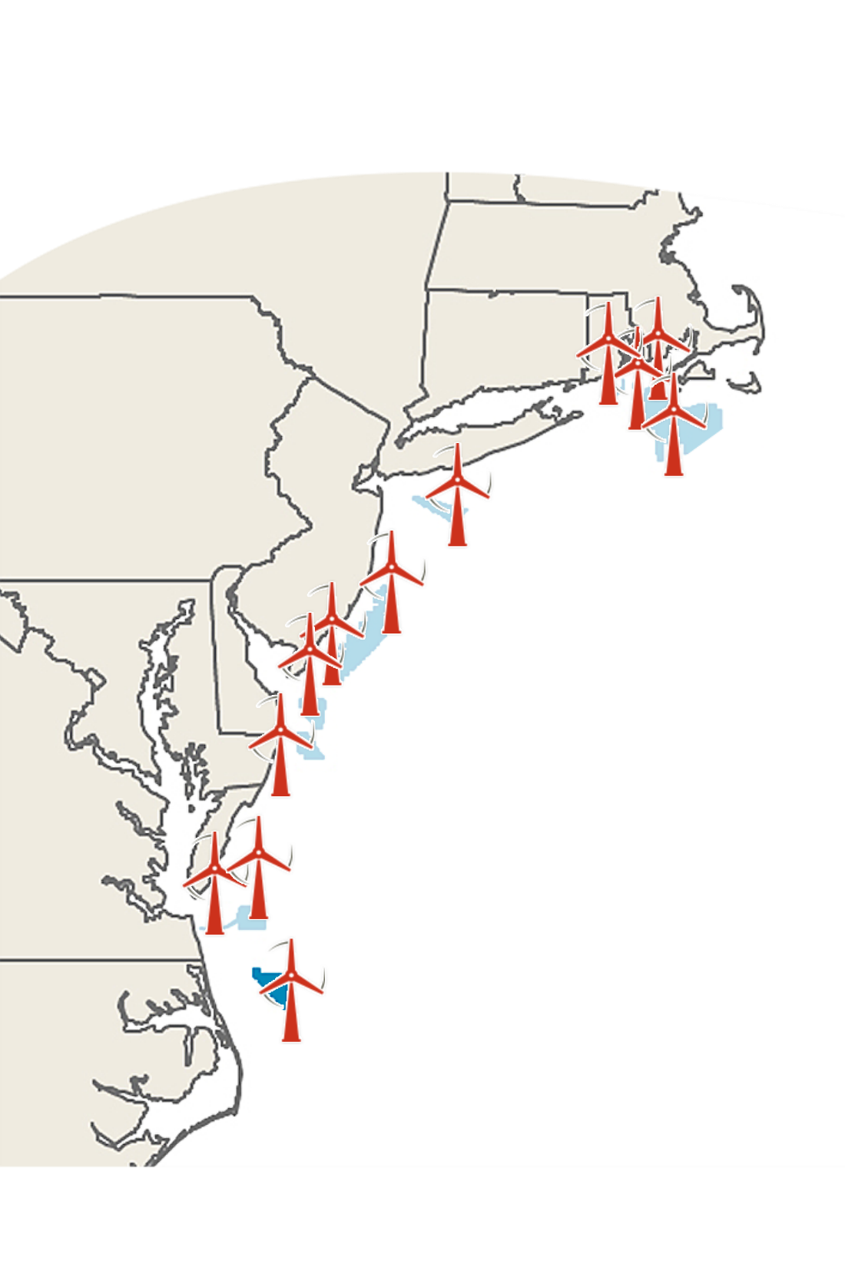
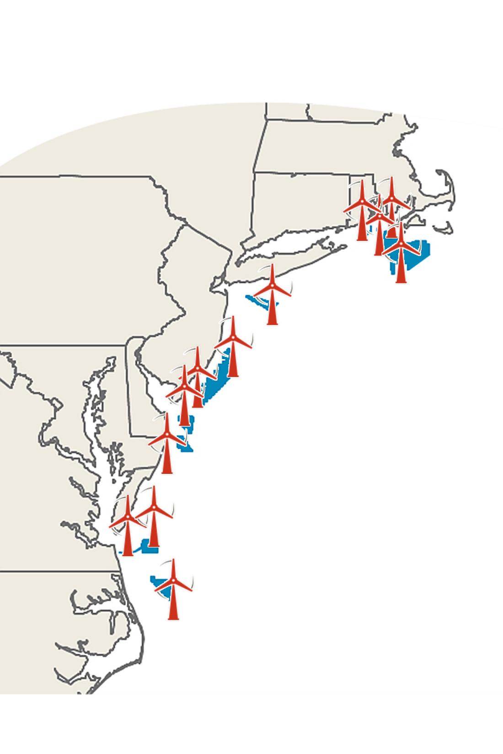
Projected timeframe for Offshore Wind Energy Projects to become operational
(based on current estimates and/or standard timeline)
Year Project Company
2020 Coastal Virginia Offshore Wind
2021 Vineyard Wind
2022 South Fork
2022 Ocean Wind
2022 Bay State Wind
2022 U.S. Wind (MD)
2023 Revolution Wind
2023 Skipjack Windfarm
2025 Dominion Commercial Lease
2025 Empire Wind
2026 EDF Renewables
2027 Kitty Hawk

