Slide 1
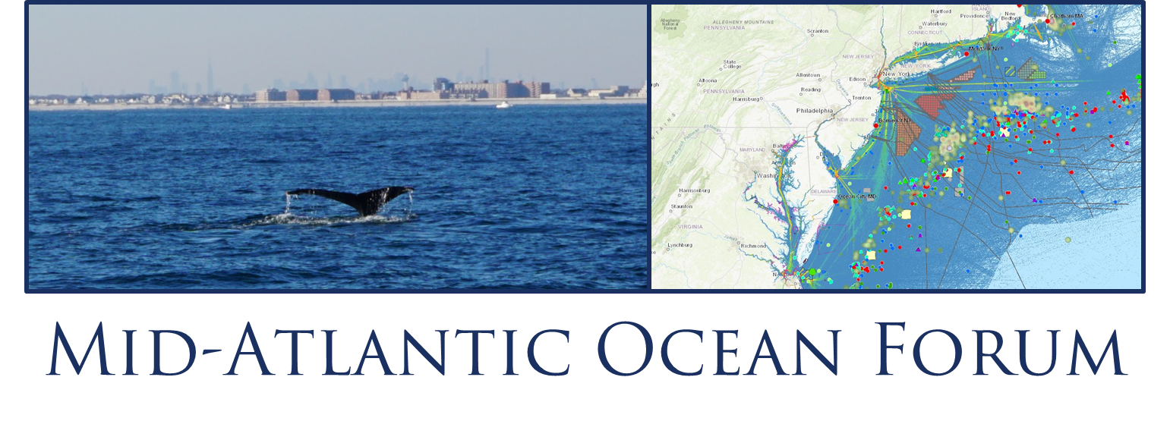
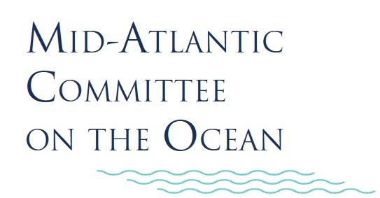
Additional Collaboration Issues:
Marine Life and Habitat

Slide 2
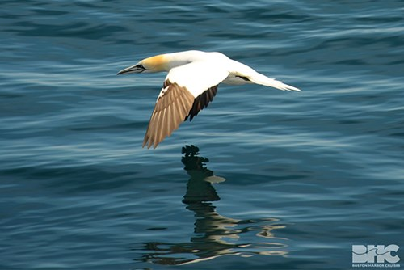
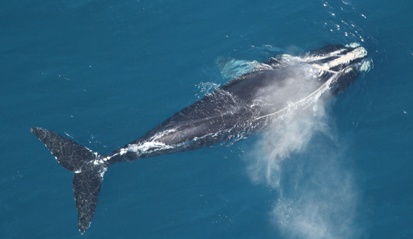
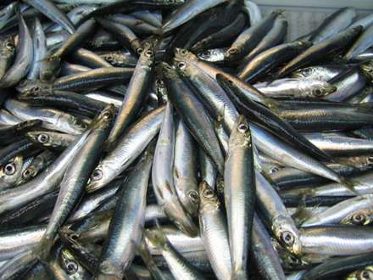
Marine Life & Habitat
Progress to Date
Updated avian and cetacean models
Updated fish data (spring trawl)
Training webinars
Projects Underway
Additional training for using portal’s marine life data
Visualization tool for long term shifts - sliders
Additional work on fish data

Slide 3
Marine Life & Habitat: Data
VA CZM Grant to The Nature Conservancy
NEFSC Bottom Trawl Survey data
(1972-2017)
Data processed using OceanAdapt code and NEFSC interpolation method
Interpolated biomass per year, species, and season
TO PORTALS:
Average biomass from 2010 to 2017 for 83 species
Most current time period
Historic data
Objectives:
Use historical data to locate areas of high biomass (core biomass areas) for each species (focus on Mid-Atlantic species)
Visualize how areas of high biomass have changed over time
Notes:
Ongoing project to update NEFSC Trawl Survey data on both Northeast and Mid-Atlantic portals (top set of boxes). This will show average biomass for the most recent time period.
VA CZM project is analyzing the same Trawl Survey data but looking at historical data dating back to the 1970s to visualize how areas of high biomass have changed over time.

Slide 4
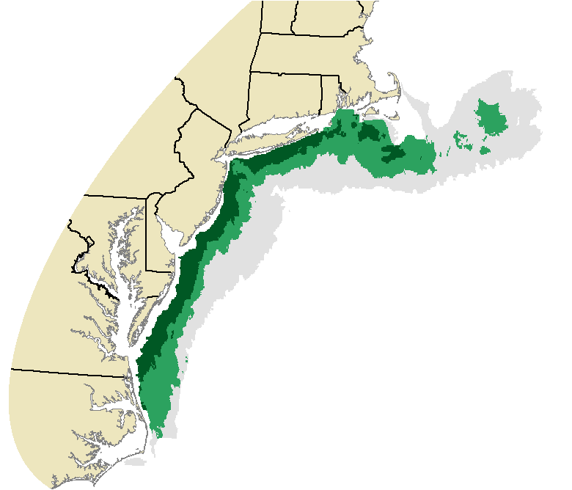
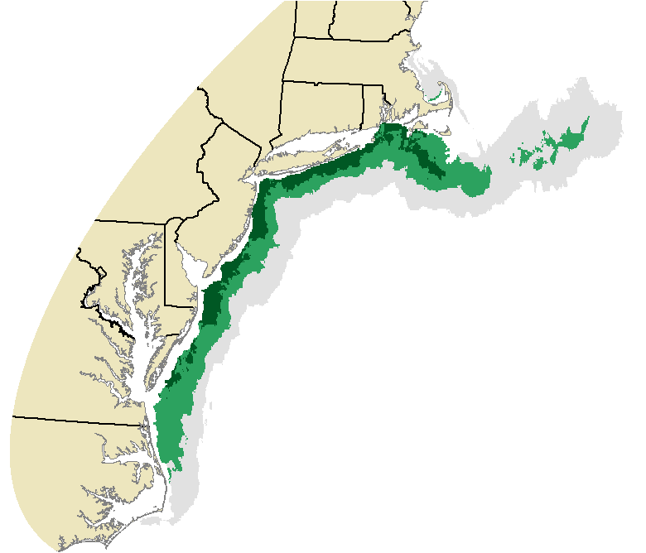
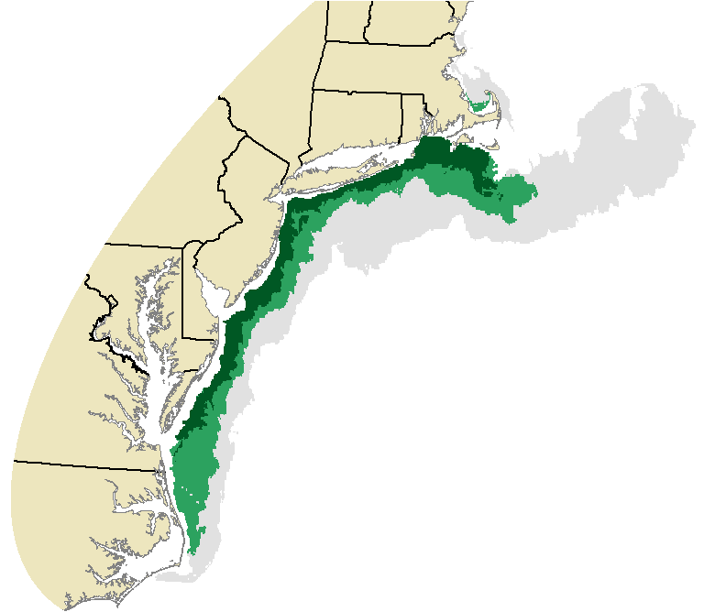
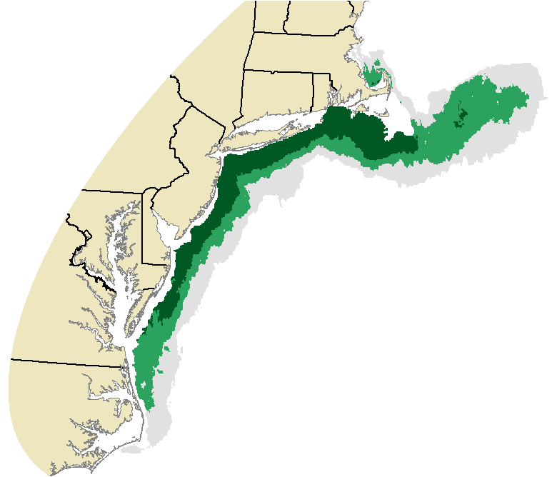
Marine Life & Habitat: Data
Summer Flounder (Fall)
Highest Biomass Area
High Biomass Area
Full Extent of Presence
1972 - 1979
1980 - 1989
1990 - 1999
2000 - 2009
2010 - 2016
Notes:
Example of changes in high biomass areas by decade for summer flounder (Fall season)

Slide 5
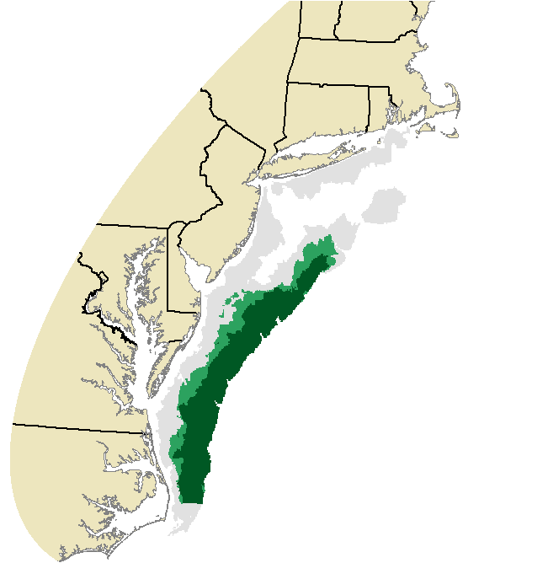
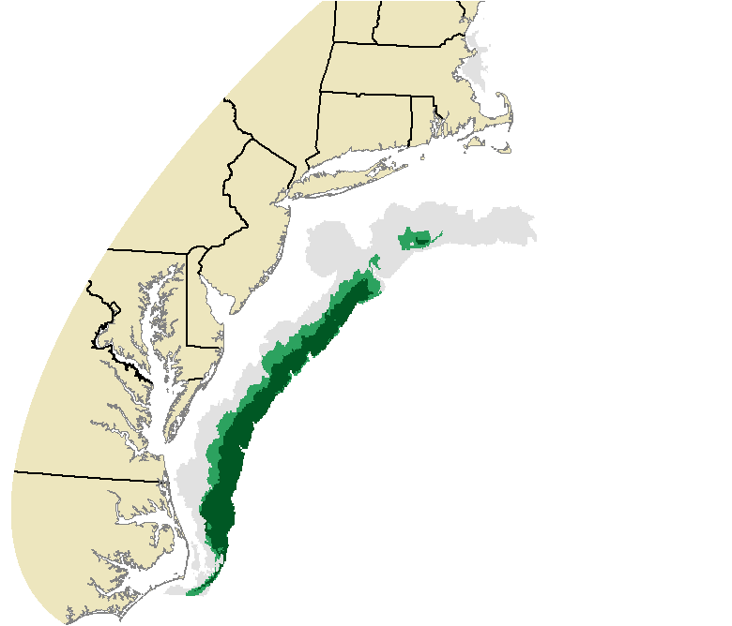
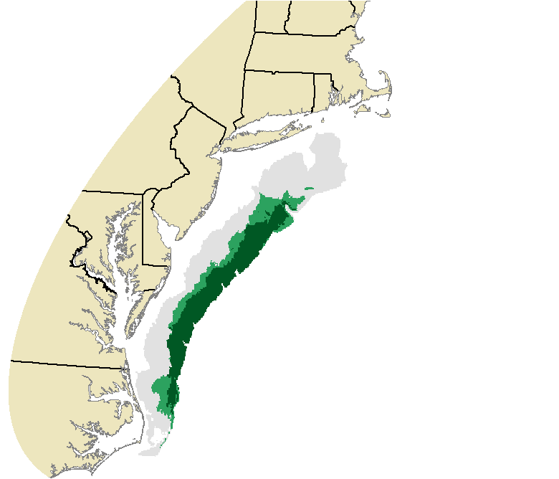
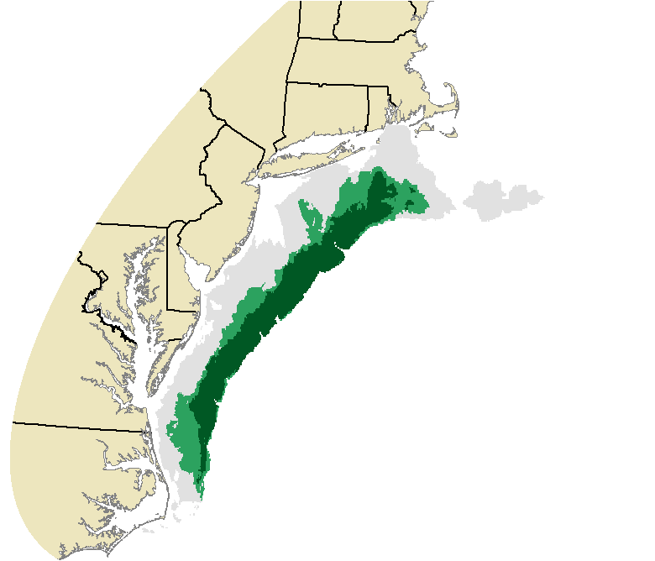
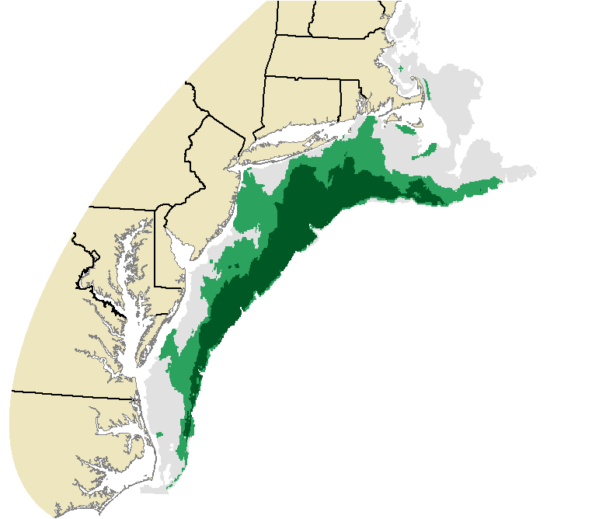
Marine Life & Habitat: Data
Black Sea Bass (Spring)
Highest Biomass Area
High Biomass Area
Full Extent of Presence
1972 - 1979
1980 - 1989
1990 - 1999
2000 - 2009
2010 - 2016
Notes:
Example of changes in high biomass areas by decade for black sea bass (Spring season)

Slide 6
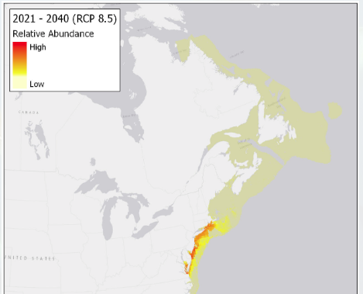
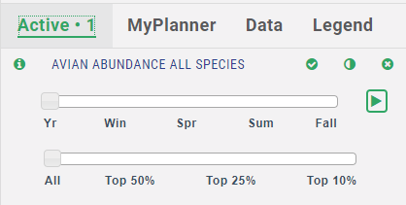
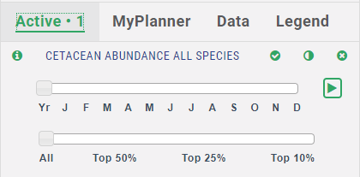
Marine Life & Habitat: Data
VA CZM Grant – Other Work
Future Projections from
OceanAdapt
Animation Sliders for Marine Mammal and Bird Data
Notes:
OceanAdapt project at Rutgers University has modeled future projections in abundance for many fish species and we’re working with them to get some of their data on the portal.
Much of the marine mammal and avian data already on the portal has a seasonal component and we’ll be implementing functionality to animate these seasonal patterns.

Slide 7
Marine Life & Habitat: Data
Mid-Atlantic Fisheries Management Council Efforts on Fish Habitat and Habitat Use:
Northeast Regional Marine Fish Habitat Assessment
Fish species shift modelling work
Ecosystem Approach to Fisheries Management

Slide 8
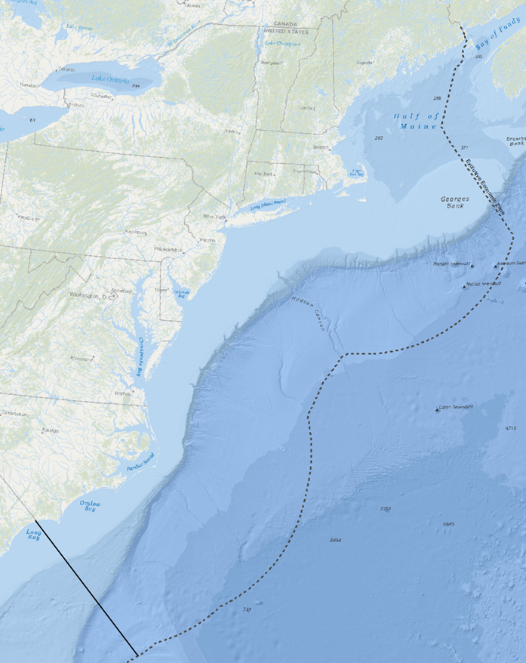
Marine Life & Habitat: Data
Add Photos

Slide 9
Marine Life & Habitat: Data
Add Photos

Slide 10
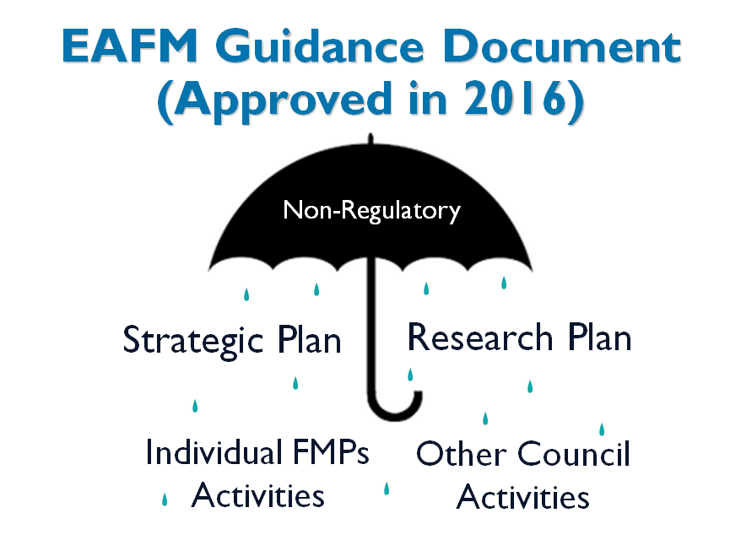
Marine Life & Habitat: Data
Add Photos

Slide 11
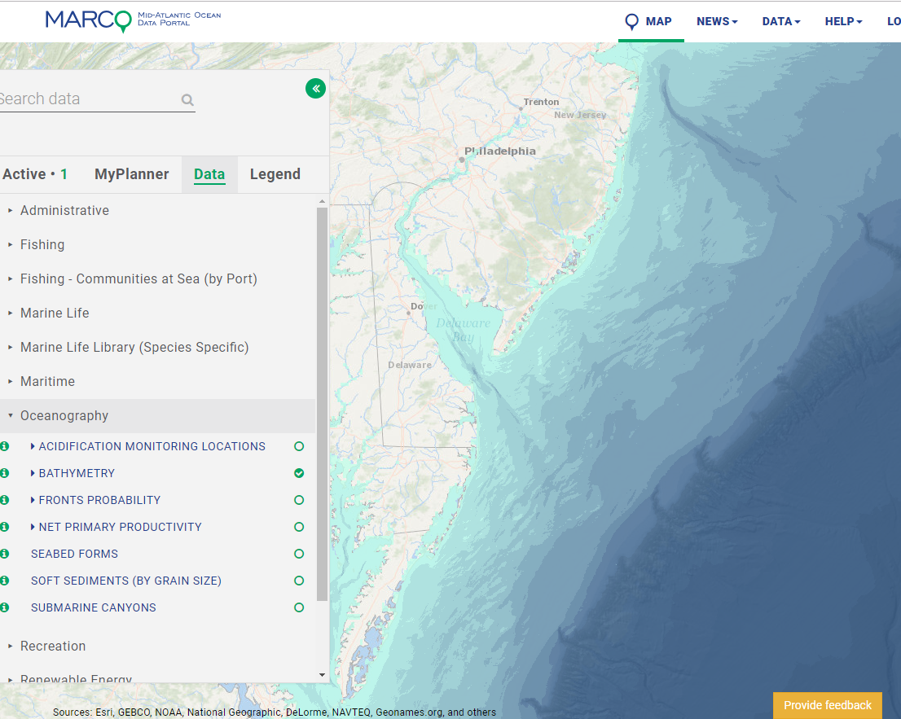
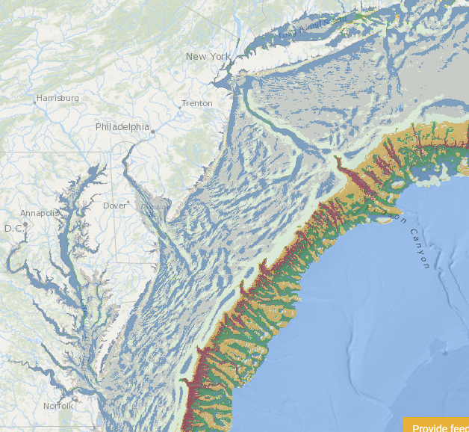
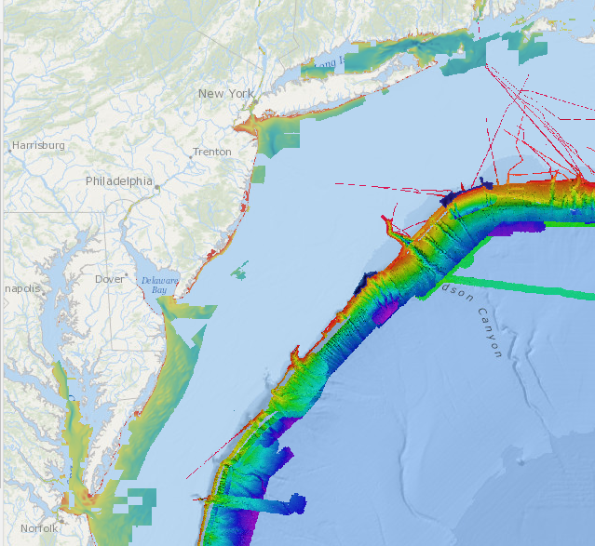
Marine Life & Habitat: Opportunities
Potential opportunities for collaboration:
Improved bathymetry data to benefit multiple agencies & purposes
Improved bottom habitat maps to understanding species shifts (and for aquaculture and energy planning)
Add bathymetry from portal and Namera layer
Regional Bathymetry
NOS Hydrographic Survey and Okeanos Bathymetry
TNC’s Seabed Forms (NAMERA): seabed position and slope

Slide 12
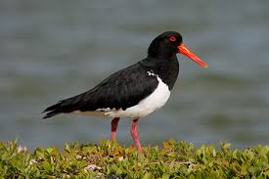
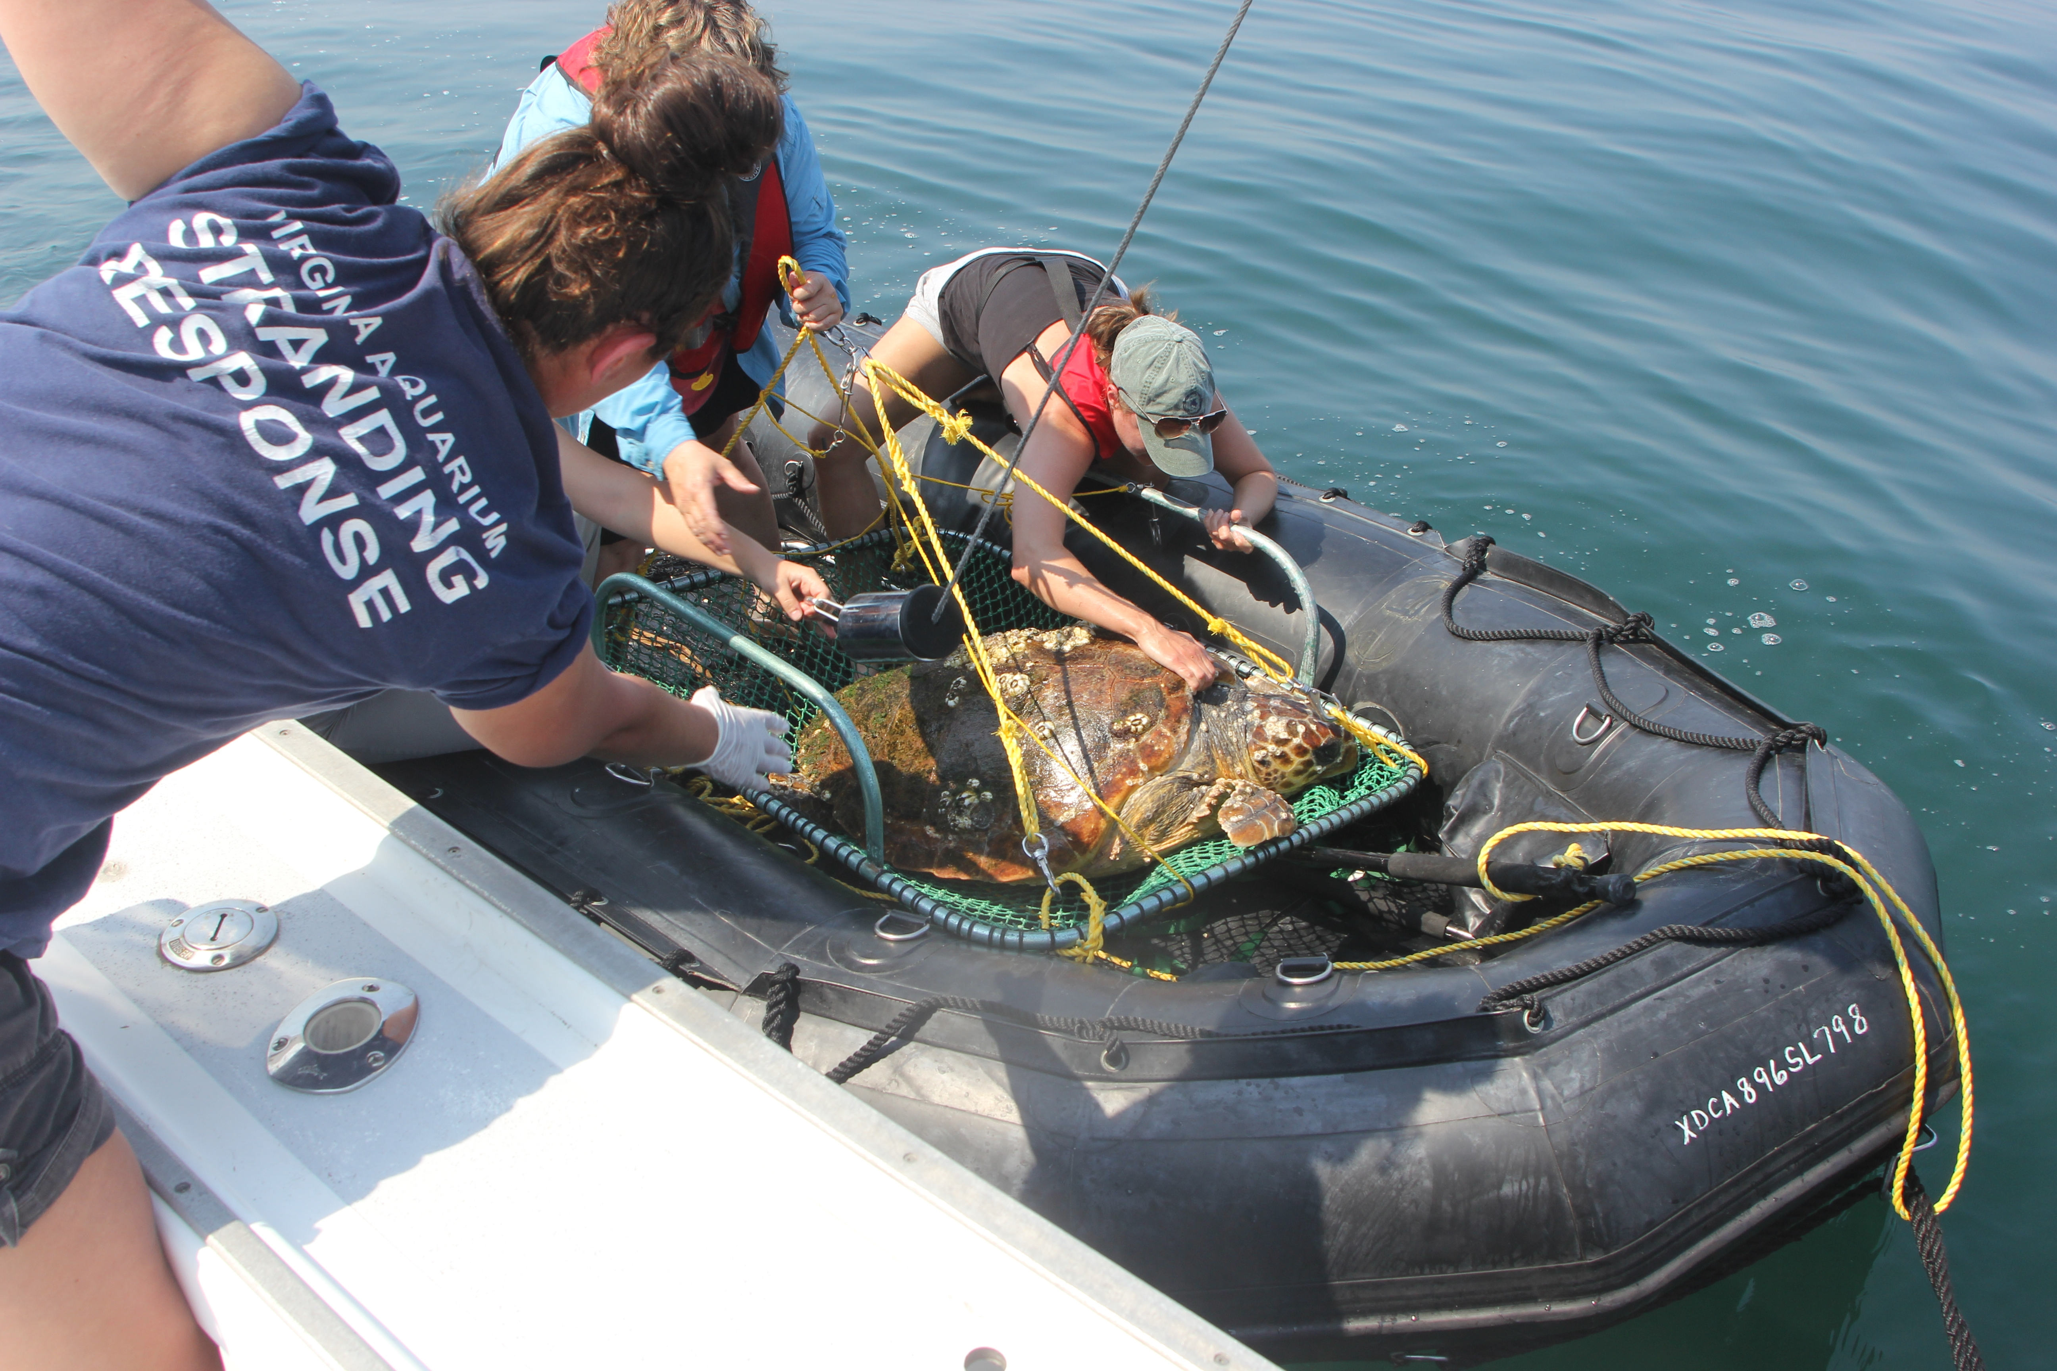
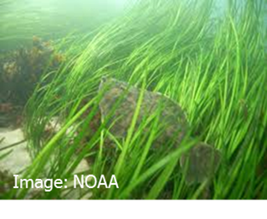
Marine Life & Habitat: Opportunities
Other suggestions?
Regional BMPs for incorporating shorebird habitat needs into shoreline management

