Slide 1
Resilience and Coastal Infrastructure
MACO Forum March 20, 2019
Kisha Santiago-Martinez, NYS Department of State
Mike Snyder, NYS Department of State

Slide 2
“While our focus is on addressing emerging challenges in the ocean environment, to be successful we will need to address the connections between upland, nearshore, and offshore areas.”
Mid Atlantic Governor’s Agreement on Ocean Conservation, 2009
“To ensure the conservation and responsible use of the nation’s valuable coastal resources by facilitating informed planning and decision making along the coast; increasing the resilience of coastal communities by anticipating and addressing coastal hazards; and ensuring a healthy coast for the public to enjoy.”
Mission statement, 2018-2023 National Coastal Zone Management Program Strategic Plan

Slide 3
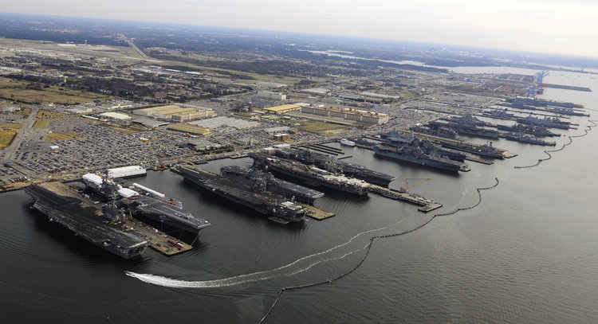
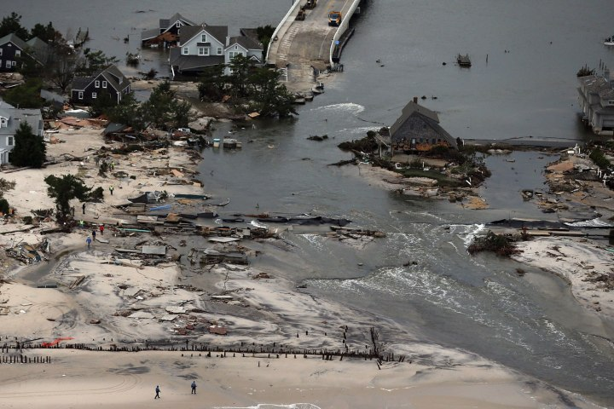
Why resilience?
https://www.businessinsider.com/us-navy-ships-flee-virginia-base-as-hurricane-florence-approaches-2018-9
Naval ships flee Virginia’s Norfolk naval station as Hurricane Florence closes in.
https://envirobites.org/2018/06/15/can-new-jersey-marshes-just-fuhgettabout-superstorm-sandy/
Aerial photograph of Hurricane Sandy storm damage at Mantoloking, New Jersey coastline.

Slide 4
“It is clear that a critical aspect of our nation’s overall resiliency is the level of resilience in the maritime and coastal sectors, each of which must be able to withstand and recover effectively from external shocks and continue to provide the services we rely upon for our economic viability and homeland security.
However, despite the clear dependencies, the interface between the maritime and coastal regions has not been an area of significant research to date.”
2016 U.S. Dept. Homeland Security Coastal Resilience Center of Excellence report; “Integrating Maritime and Coastal Resilience”
Figure 1. Maritime Transportation System, juxtaposed with ecological and community systems. (Image Credit: Touzinsky, U.S. Army Corps of Engineers, Resilience Integrated Action Team, http://www.cmts.gov/Activities/ActionTeams.aspx).

Slide 5
Coastal communities
Water-dependent economies
Tourism
Vulnerable populations
Cultural heritage& identity
Coastal infrastructure
Ports
Rail
Roads
Bridges
Energy
Wastewater
Water quality
Ocean acidification
Ocean debris
Wastewater
Shellfisheries
Tourism
Working waterfronts
OCEAN & COASTAL RESILIENCE
Beaches
Public access
Habitat
Tourism &Local economies
Coastal processes
Dunes
Sand/sediment management
Risk reduction
Fisheries
Local economies
Food webs
Habitat
Working waterfront
Tourism
Cultural heritage and identity
Shifting species
Marine habitat
Estuarine
Tidal wetlands
Risk reduction
Aquaculture
Fisheries
Corals and canyons

Slide 6
Resilience and Coastal Infrastructure
Kisha Santiago-Martinez, NYS Department of State
Kisha.Santiago@dos.ny.gov
Michael Snyder, NYS Department of State
Michael.Snyder@dos.ny.gov

