Slide 1
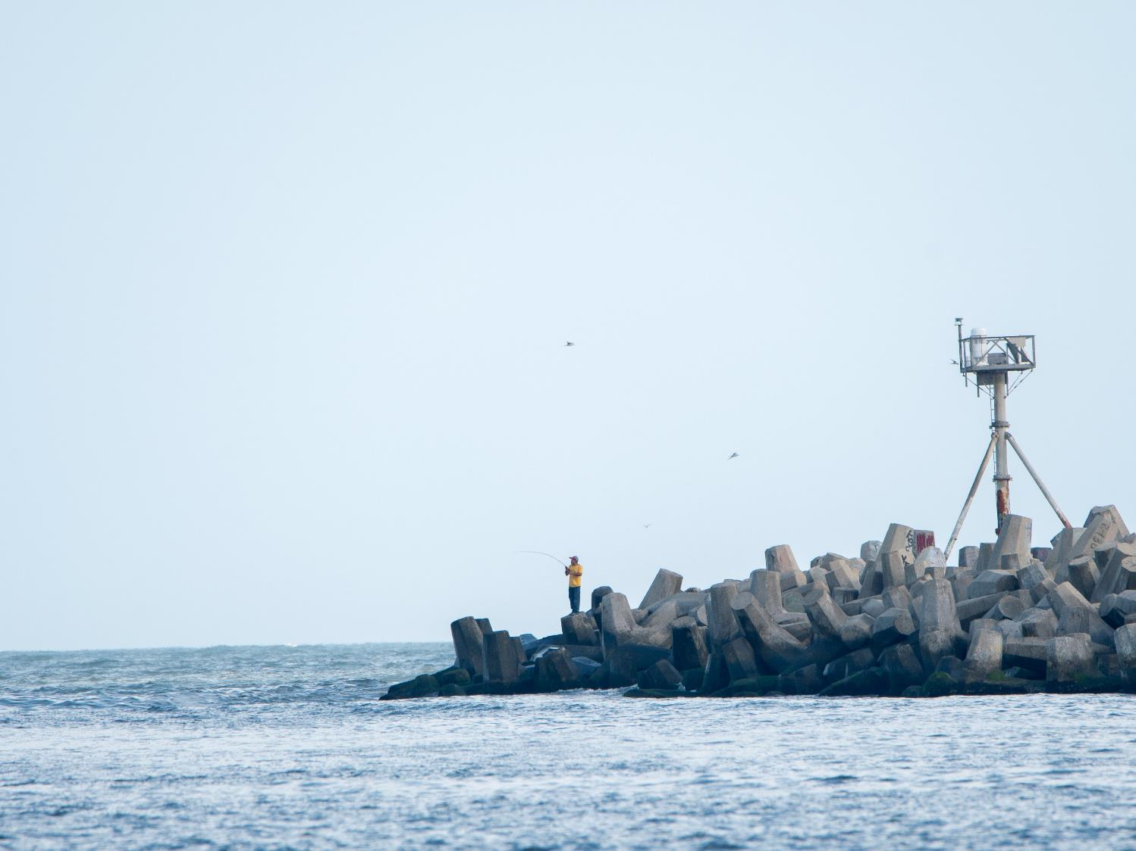
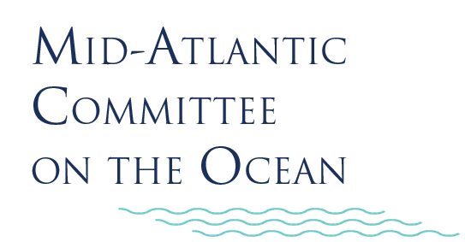
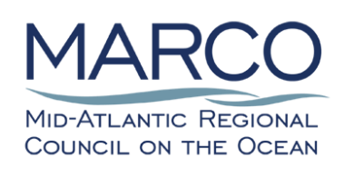
MACO Stakeholder Outreach Webinar
January 11, 2022

Slide 2
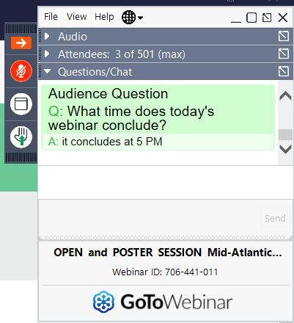
Instructions for Participants
  Attendees are in listen-only mode by default.
  You can type questions or comments at any time in the Questions/Chat pane.
  Forum Discussion: To make verbal comments, click the Hand icon to raise your hand. When called on, click the Mic icon to unmute yourself.
  Comments are always welcome via info@midatlanticocean.org.
  Session is being recorded.
Mic
Hand
Questions/ Chat Pane

Slide 3
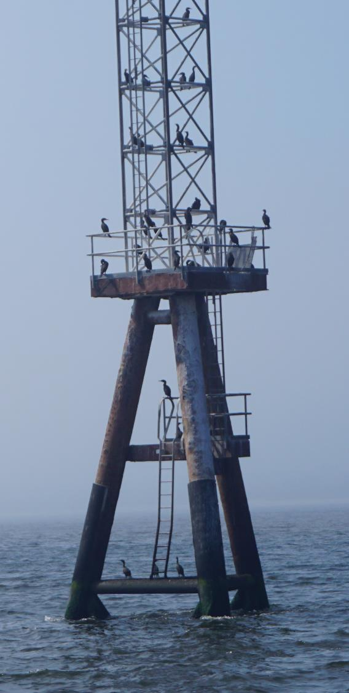
Meeting Objectives
Provide an update on MACO’s activities and plans.
Introduce future opportunities for engagement around ocean justice in MACO’s work.
Provide updates on the White House Ocean Policy Committee and administration executive order activity.
Obtain feedback on MACO priorities for 2022 and 2022 Ocean Forum topics and logistics.

Slide 4
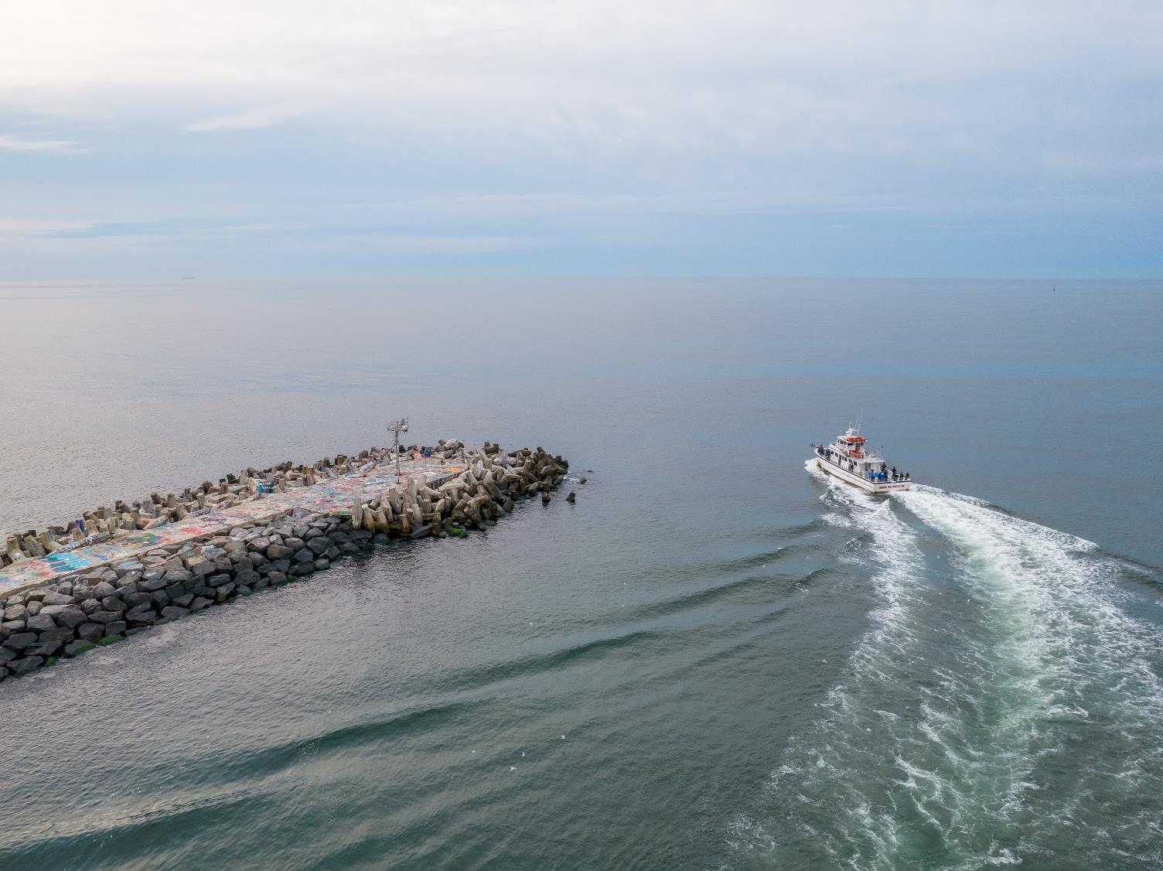
Looking Back on 2021

Slide 5
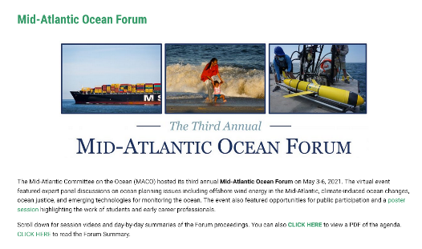
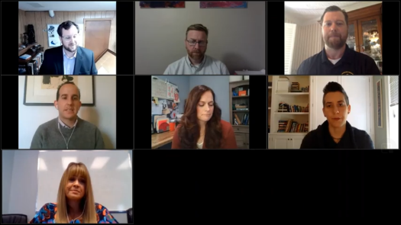
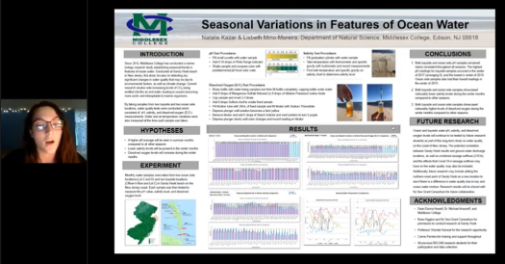
2021 Mid-Atlantic Ocean Forum
For session videos and day-by-day summaries of the Forum proceedings, visit:
midatlanticocean.org/ mid-atlantic-ocean-forum/2021-forum/

Slide 6
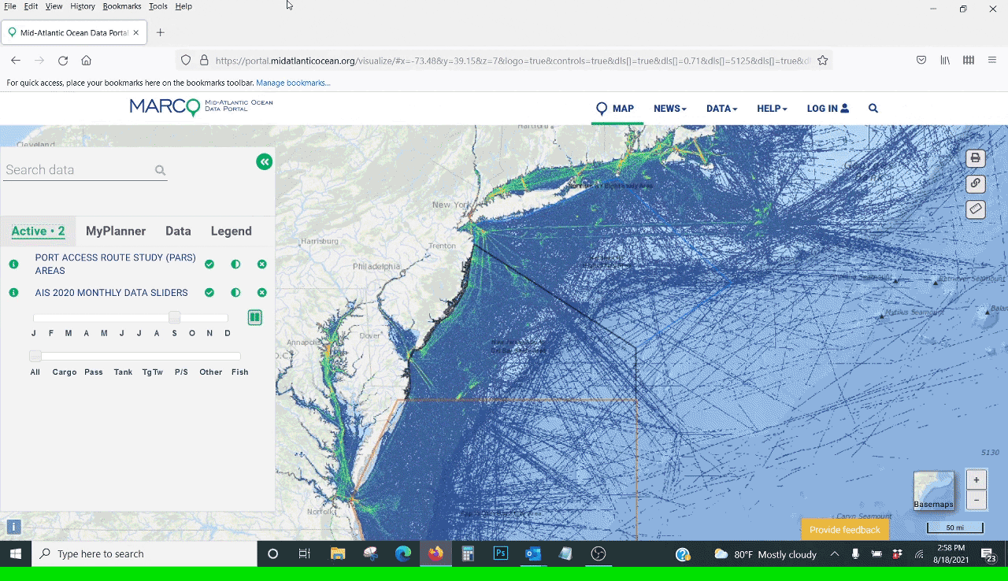
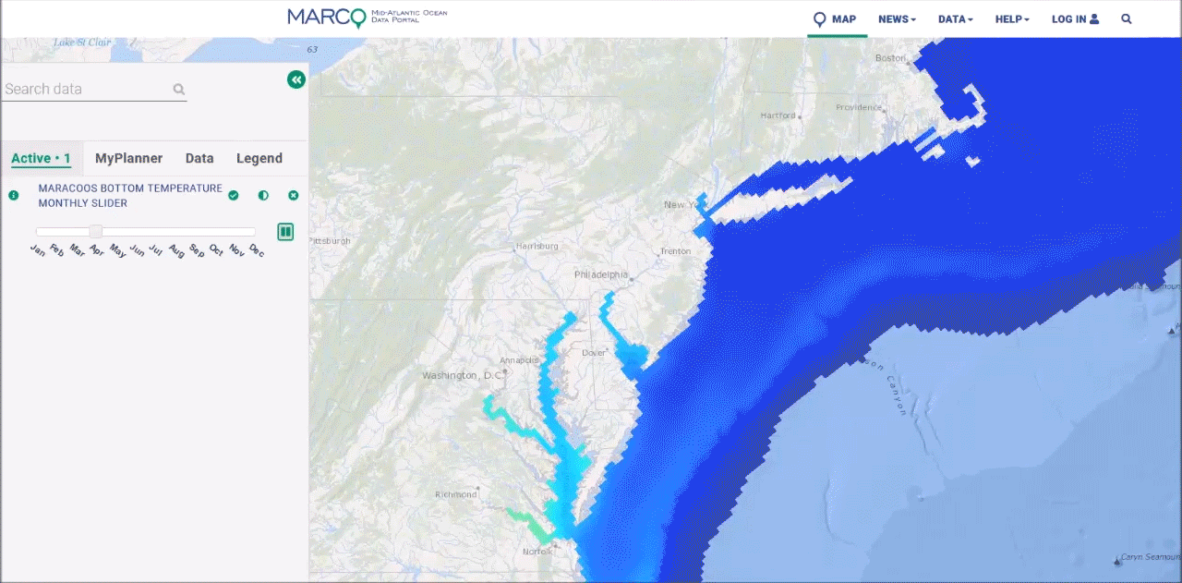
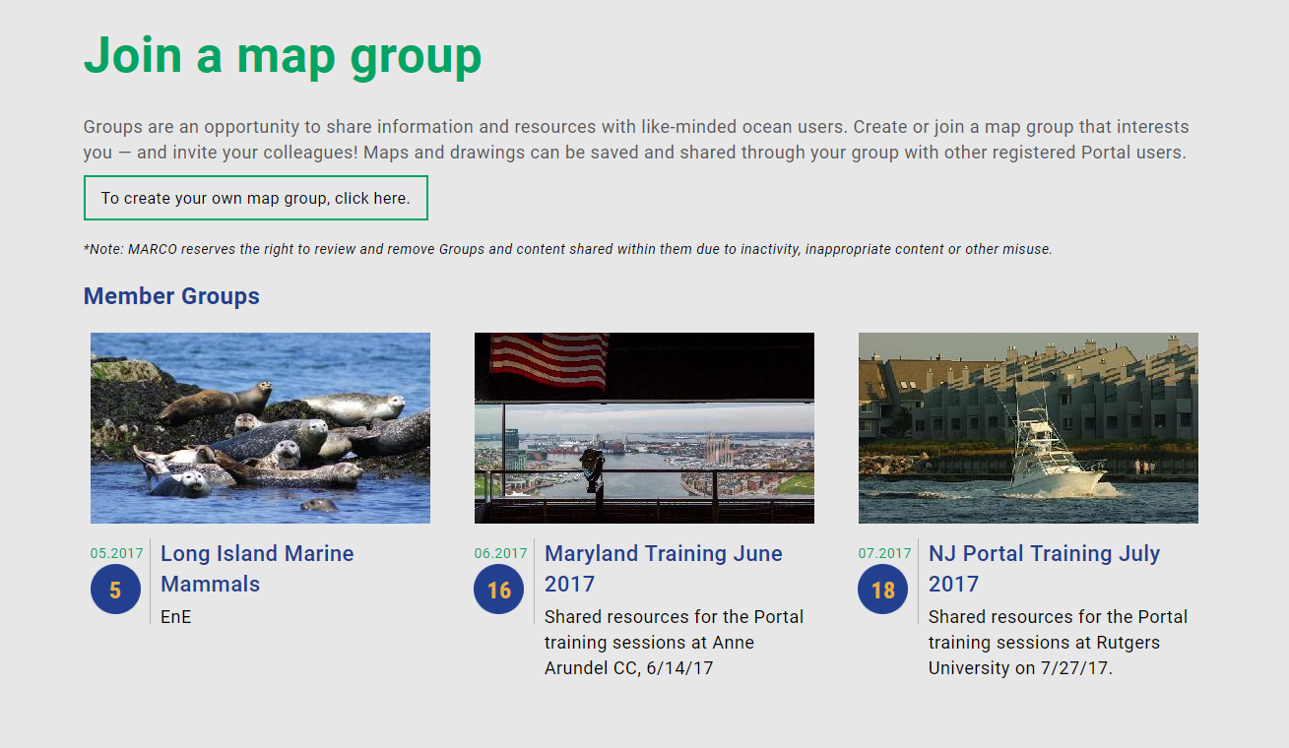
Looking Back: Ocean Data Portal
For more updates: portal.midatlanticocean.org/news
Maritime: Port Access Route Studies, 2020 vessel traffic
Marine Life: Updated fish species and group distributions, black-capped petrel movements
MARACOOS monthly average sea bottom temperatures
Tool Enhancements: Private Groups, expanded Drawings tool

Slide 7
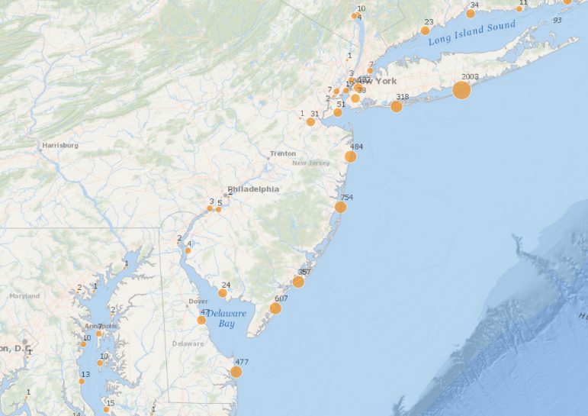
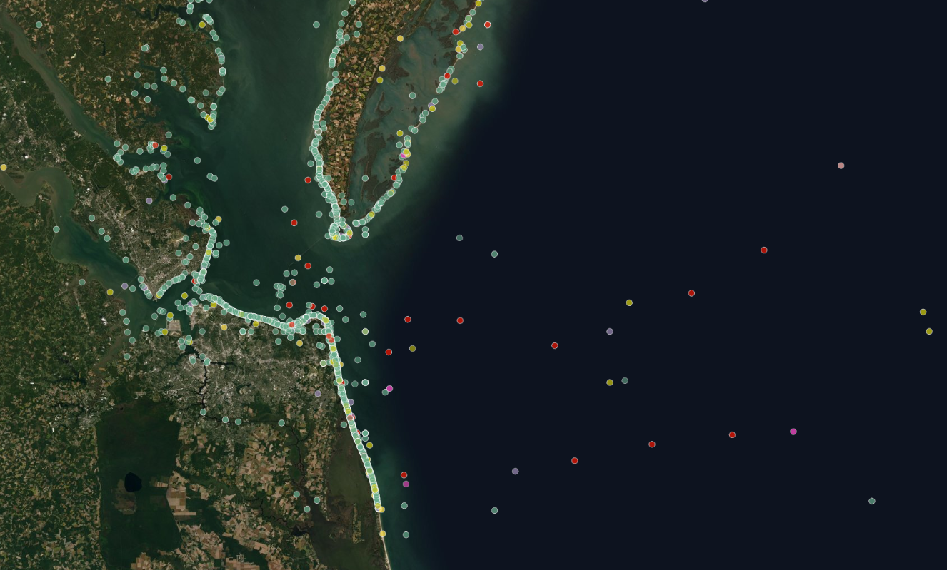
Looking Ahead: Portal 2022 Work Plan
Marine Life: MDAT right whale model updates, fish species and group maps 1980-2010, marine mammal strandings, research via RWSE
Offshore wind updates
Other proposed offshore projects and agency actions
Fisheries data updates
Recreation: Whale/dolphin watch areas, coastal recreation sites, SCUBA diving areas

Slide 8
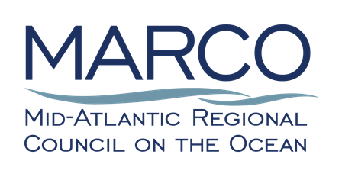

MARCO Signs MOU with MARACOOS
Strengthens and expands collaboration
Ensures data development plans are closely aligned
Formalizes commitment to continue co-coordinating the Mid-Atlantic Coastal Acidification Network

Slide 9
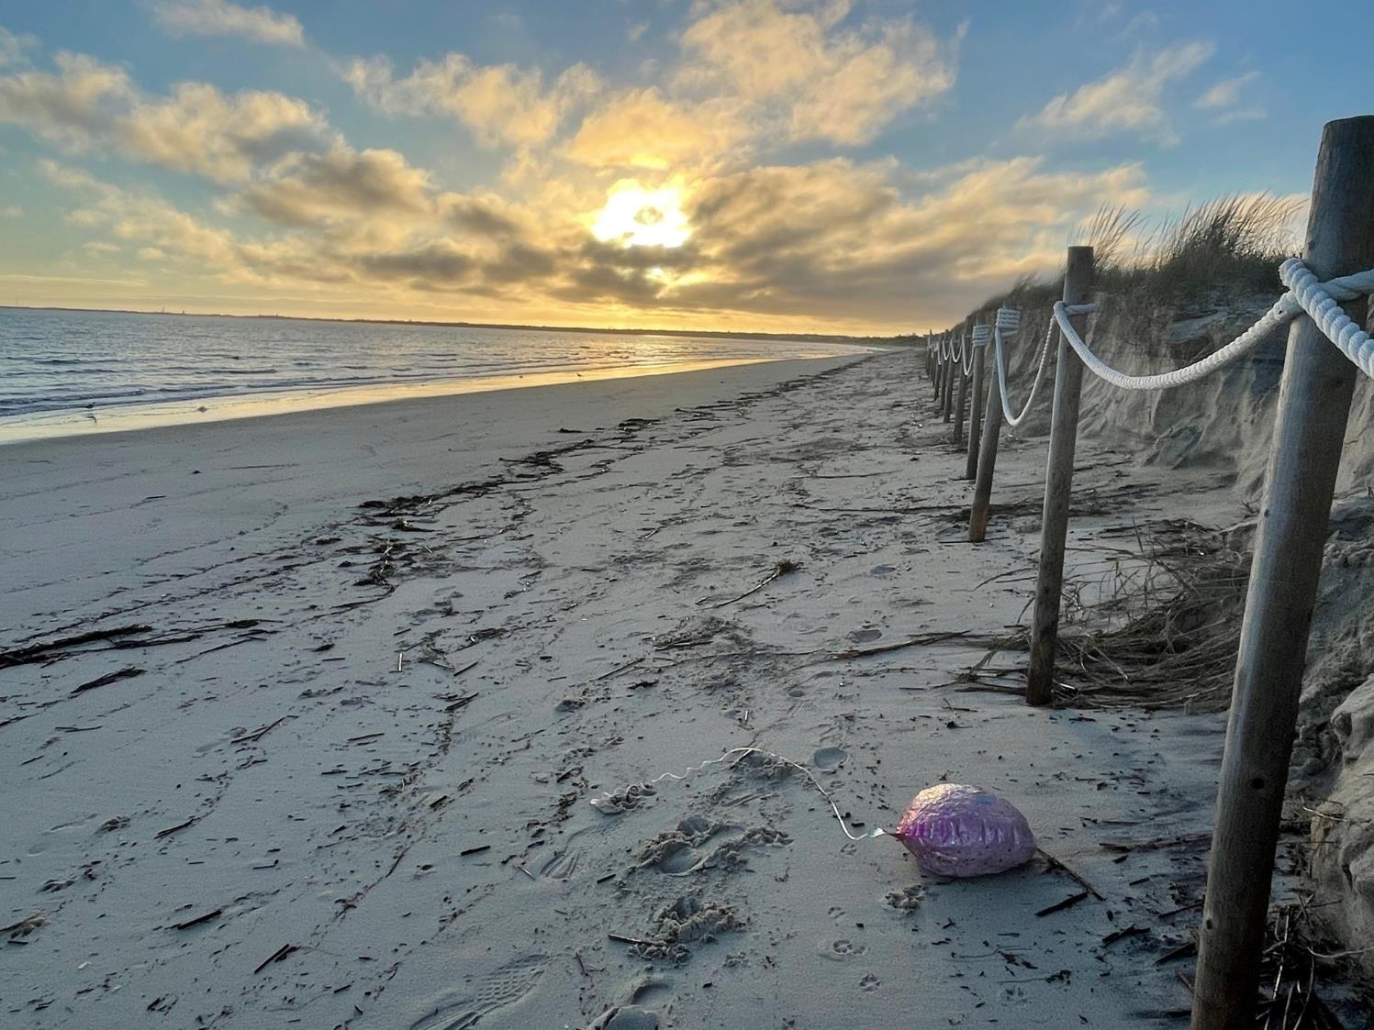
Marine Debris Reduction & Prevention
Areas of Concentration:
Reduction and prevention of litter such as balloons that pose a hazard to marine life

Slide 10
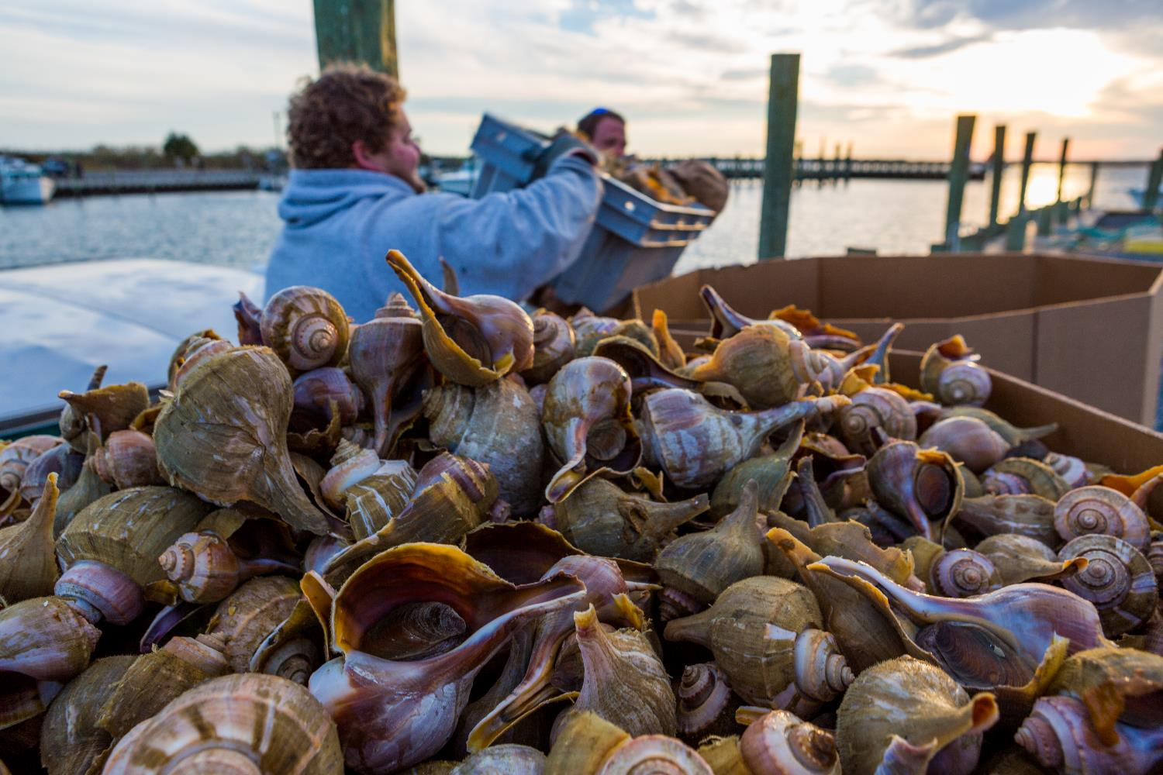
Ocean Acidification/MACAN
Areas of Concentration:
The continued development of a comprehensive ocean acidification monitoring network and research plan through the Mid-Atlantic Coastal Acidification Network

Slide 11
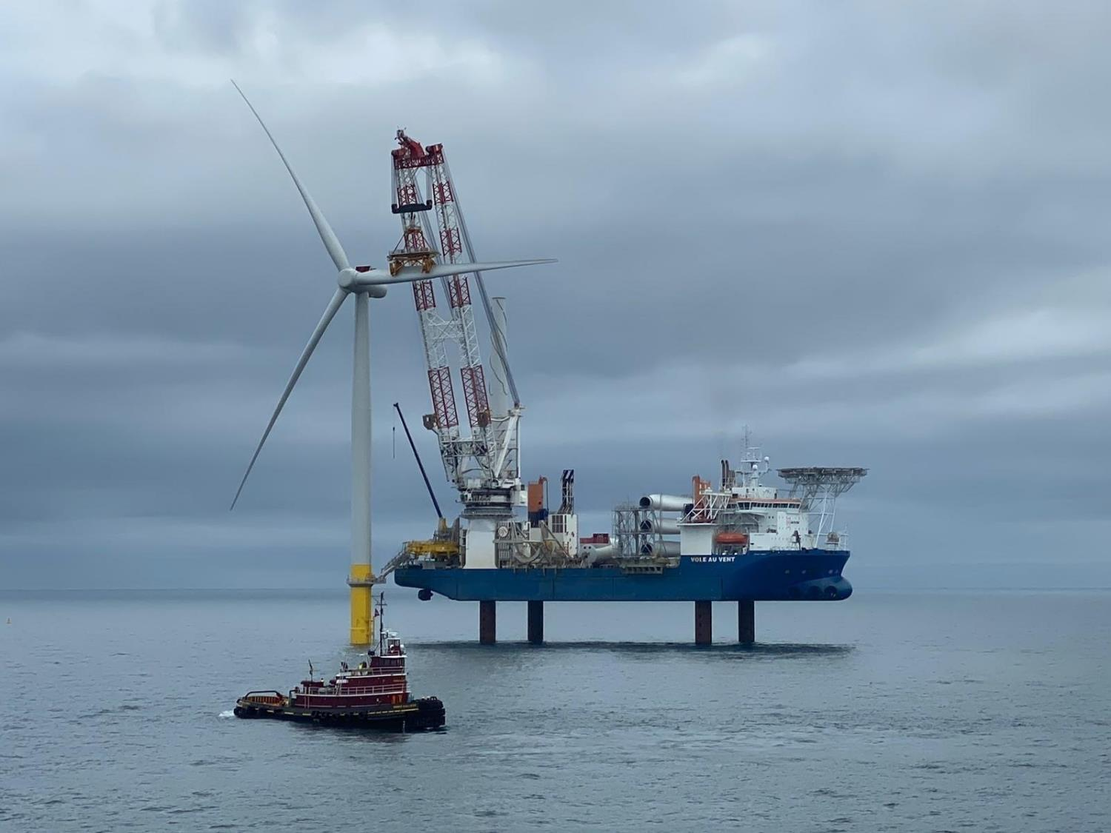
Offshore Wind Regional Collaboration
Areas of Concentration:
A forum for regular interagency discussion around offshore wind development in the region and access to data on the Portal, environmental reports, and proposed offshore wind development activities.

Slide 12
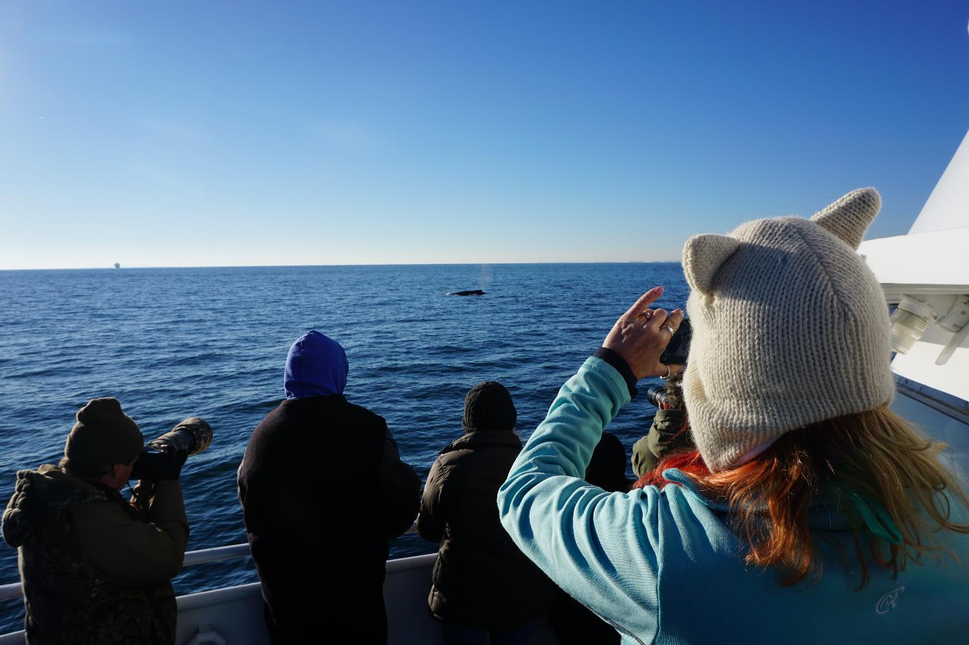
Non-Consumptive Recreation
Areas of Concentration:
Increased consideration of the importance of non-consumptive recreation

Slide 13
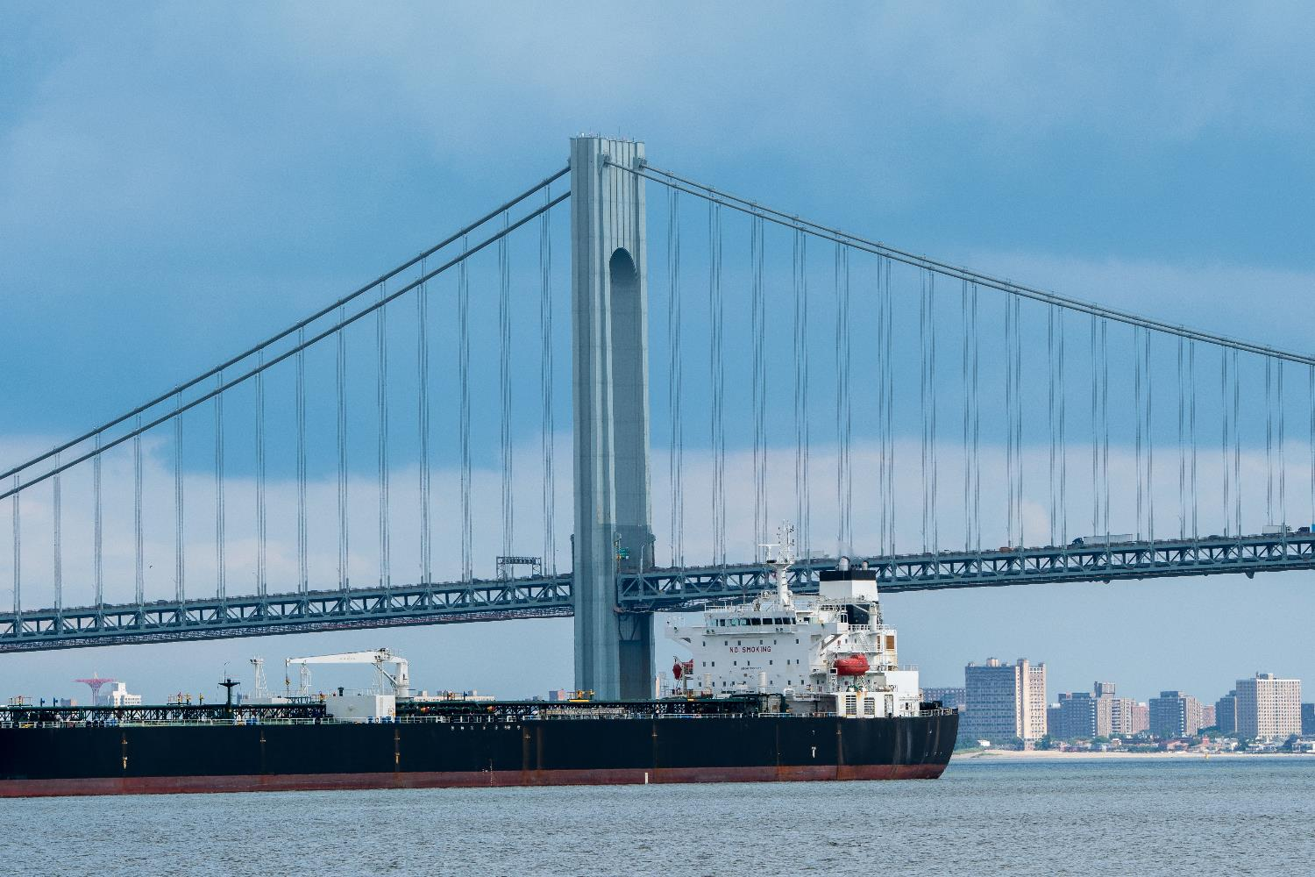
Maritime Commerce & Navigation Safety
Areas of Concentration:
Integration of the safe transit of people and goods into regional planning efforts

Slide 14
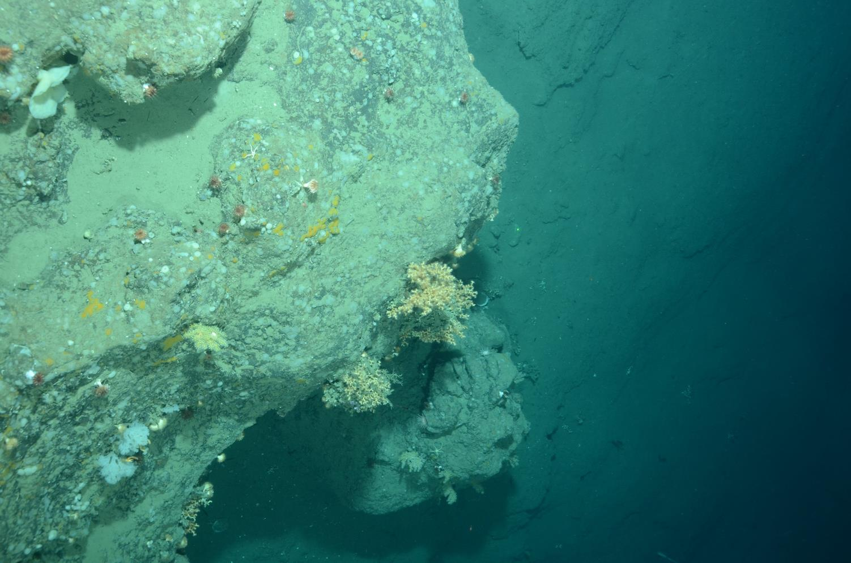
Deep Sea Canyon Habitat
Climate Change and Impacts to Deep-sea Corals Webinar
Story Maps
Exploring the Unexplored: Deep-Sea Canyons of the Mid-Atlantic
Deep-Sea Treasures of the Mid-Atlantic: Norfolk, Hudson and Baltimore Canyons

Slide 15
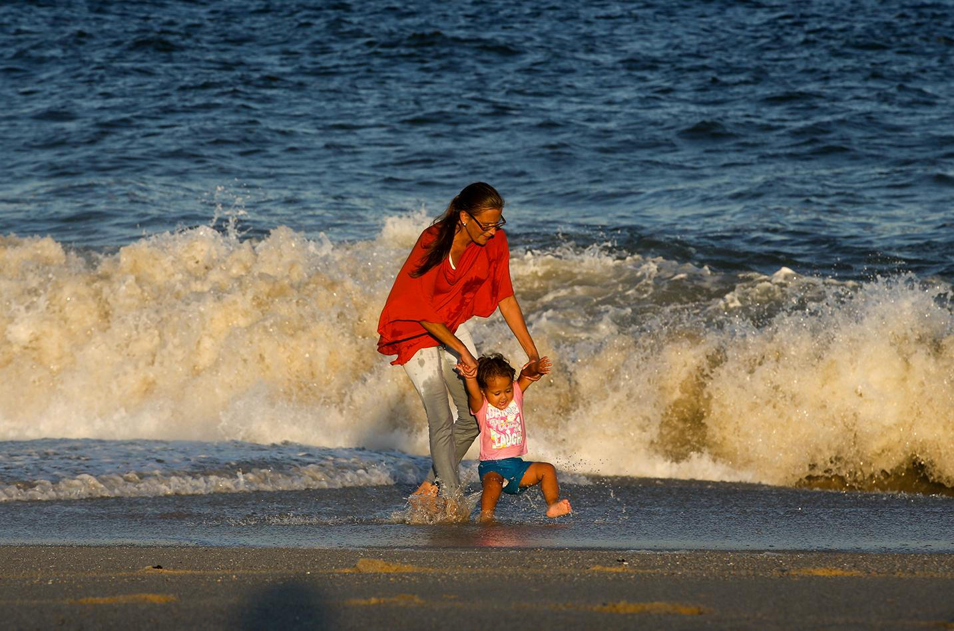
DEIJ & Ocean Justice
MARCO and MACO are committed to listening and incorporating information from the widest possible set of stakeholders to better understand and address injustices and inequities in their work. Read MACO’s Statement on Diversity, Equity, Inclusion and Justice at midatlanticocean.org

Slide 16
Looking Back on 2021
Questions? Comments?

Slide 17

Ocean Policy Committee Update
Deerin Babb-Brott
Principal Assistant Director,
Oceans and Environment
Office of Science and Technology Policy
www.whitehouse.gov/ostp www.ostp.gov
@WHOSTP

Slide 18
Ocean Policy Committee Update (Part I)
Ocean Policy Committee
Support and enhance regional decision-making and stakeholder engagement
Advance a sustainable ocean economy
Develop ocean-climate solutions to mitigate for and adapt to climate change
Connect investment in and application of applied ocean science and technology to management needs
Regional Decision-making and Stakeholder Engagement
Focus on support for regions increasingly reflected in policy and budgets
Ocean Policy Committee (OPC) authorizing legislation directs engagement and support for regions
Immediate example is $56m/5 years in Bipartisan Infrastructure Law for ROPs and each of 9 regions
OPC will build on NE and Mid-A lessons learned and engagement practices and data portals as national models
Sustainable Ocean Economy
In November, U.S. joined the High Level Panel for a Sustainable Ocean Economy
Key commitment is to develop a strategy and plan to sustainably manage the U.S. EEZ
OPC will collaborate with stakeholders and key regional entities – ROPs, FMCs, R/As, other to develop overall approach
OPC will engage this winter/spring in regional conversations to help scope the approach that advances regional interests

Slide 19
Ocean Policy Committee Update (Part II)
Develop Ocean-Climate Solutions
Green shipping, blue carbon, and ocean renewables provide significant potential emissions reductions
Other actions ongoing or under development provide adaptation benefits (coastal resilience, fisheries, other)
OPC will coordinate development of ocean-climate action plan that builds on agency actions and timelines
Applied Ocean Science and Technology
Focus on “use-inspired” S&T as opportunity to advance regional management (wind/resource interactions, for ex)
Strong support for agency engagement and private sector/regional partnerships in National Oceanographic Partnership Program
Connect regionally identified needs with agency investment in NOPP projects: focus on communicating regional S&T priorities to OPC

Slide 20
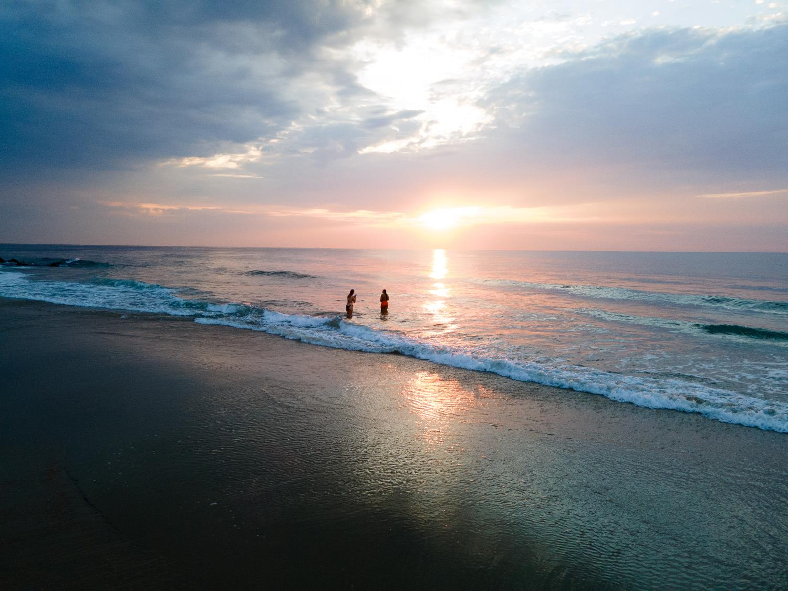
Looking Forward:
2022 Mid-Atlantic Ocean Forum

Slide 21
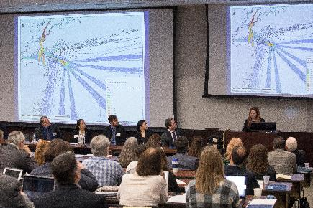
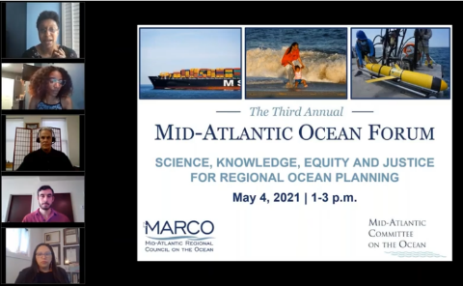
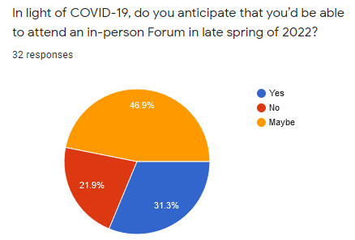
Mid-Atlantic Ocean Forum
What Aspects of these Topics Would You Like Addressed?
  Offshore Wind
  Ocean Conservation
  Ocean Science, Data and the Mid-Atlantic Portal
  DEIJ in the Context of Ocean Planning
Event Format
  Virtual or In Person?

Slide 22
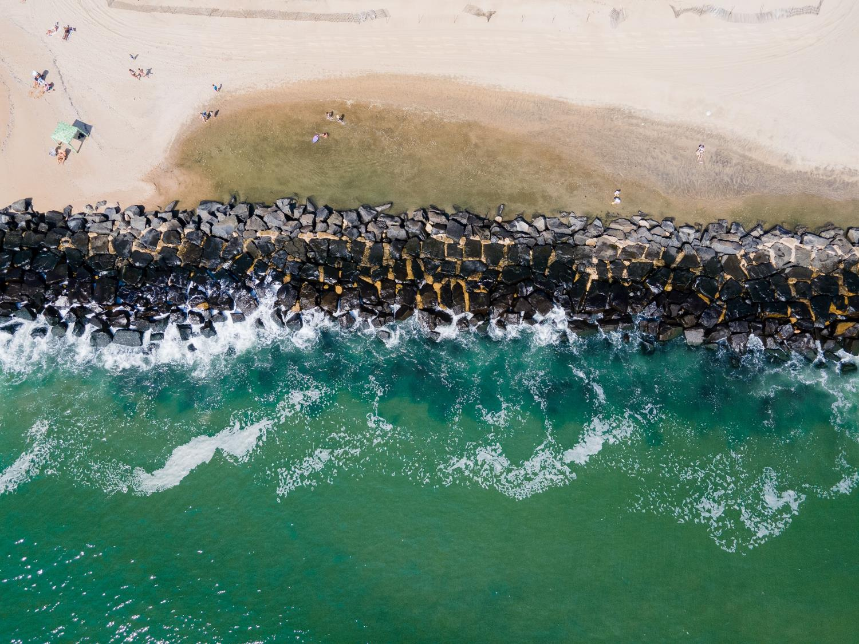
Open Comments and Next Steps

Slide 23
Thank You

